Slide 1
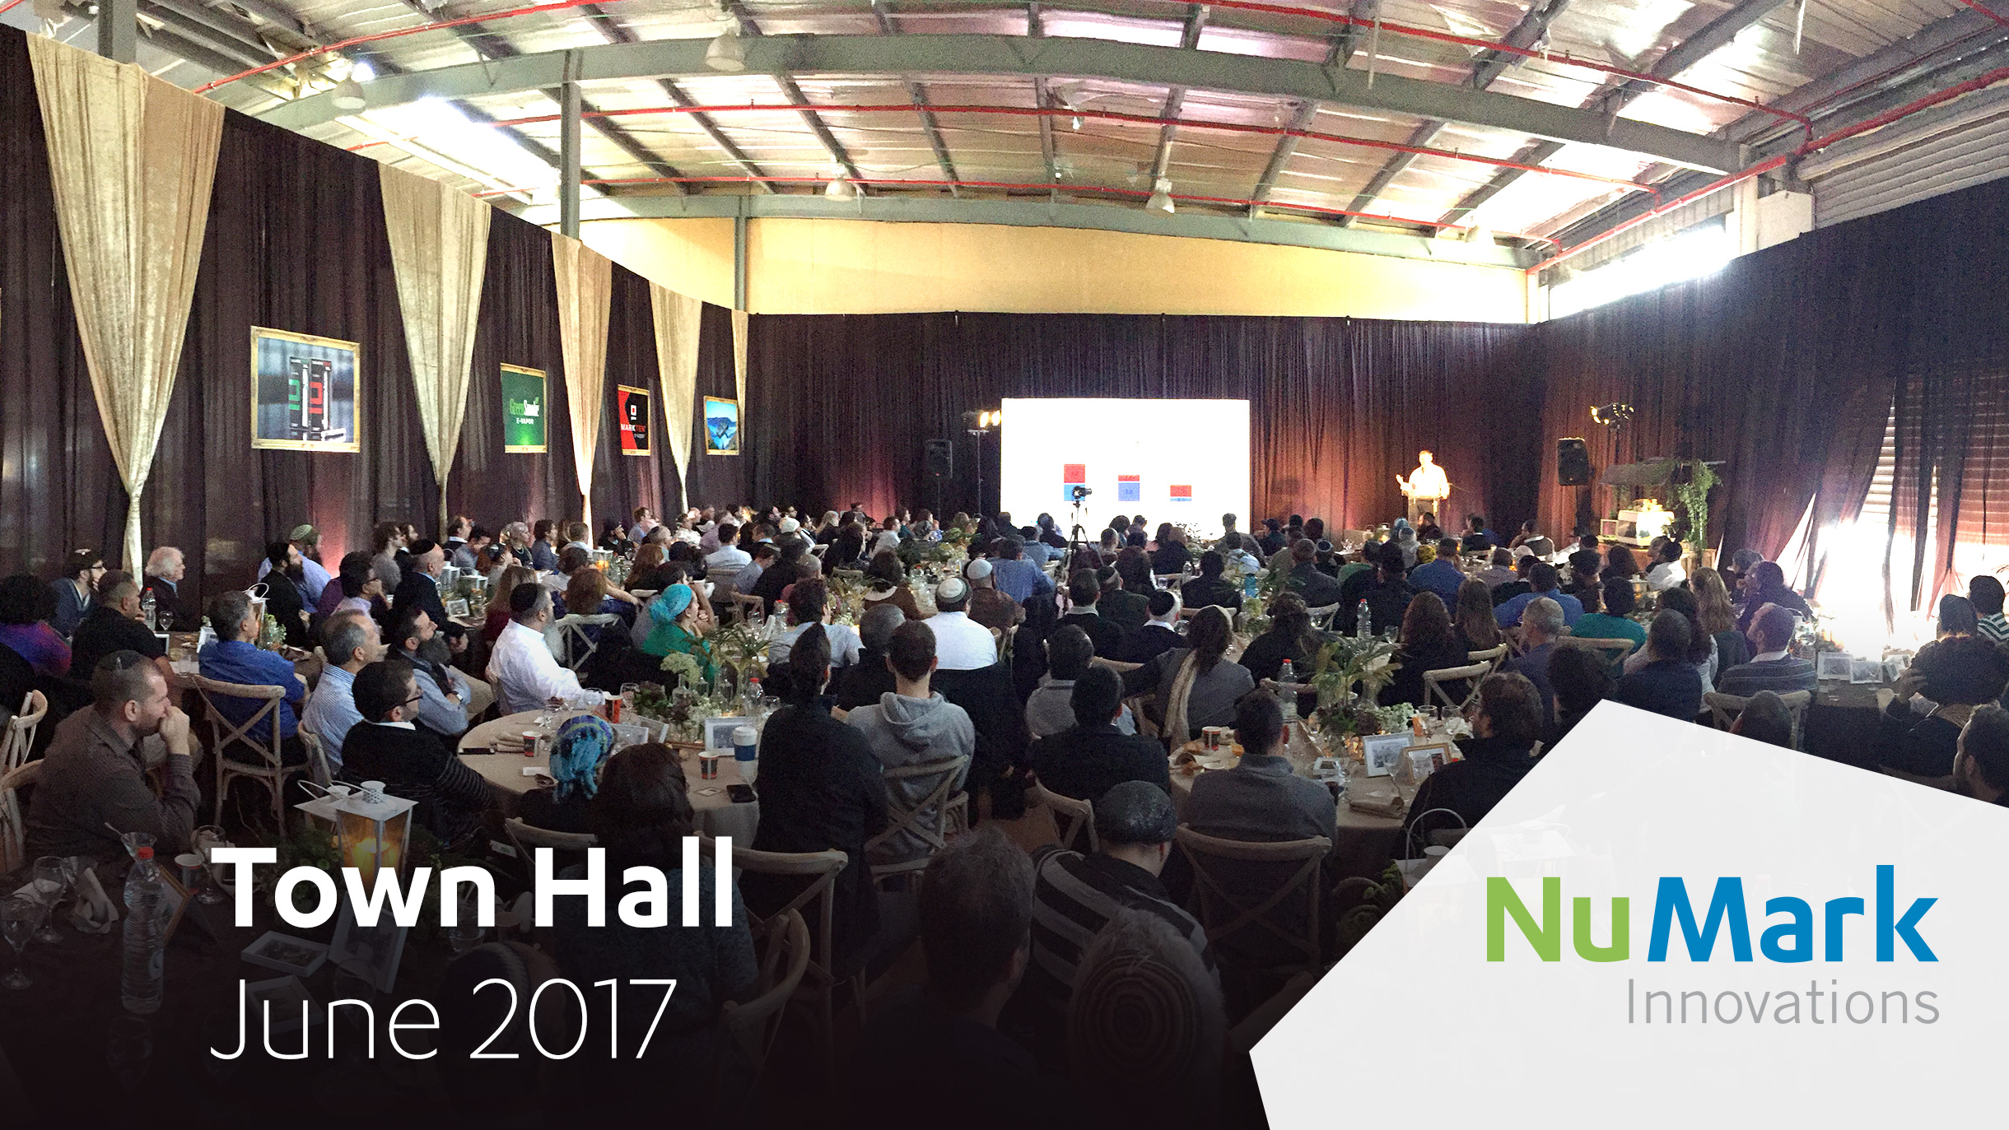

Slide 2
Agenda
10:30 - 11:00 Brunch
11:00 - 11:30 Meet the Leadership
11:30 - 11:50 Break
11:50 - 12:10 Inside NMI
12:10 - 12:30 Awards
12:30 - 13:30 Fair Fun & Food

Slide 3


Slide 5


Slide 6
Reuven Levitz
CEO of Nu Mark Innovations

Slide 7
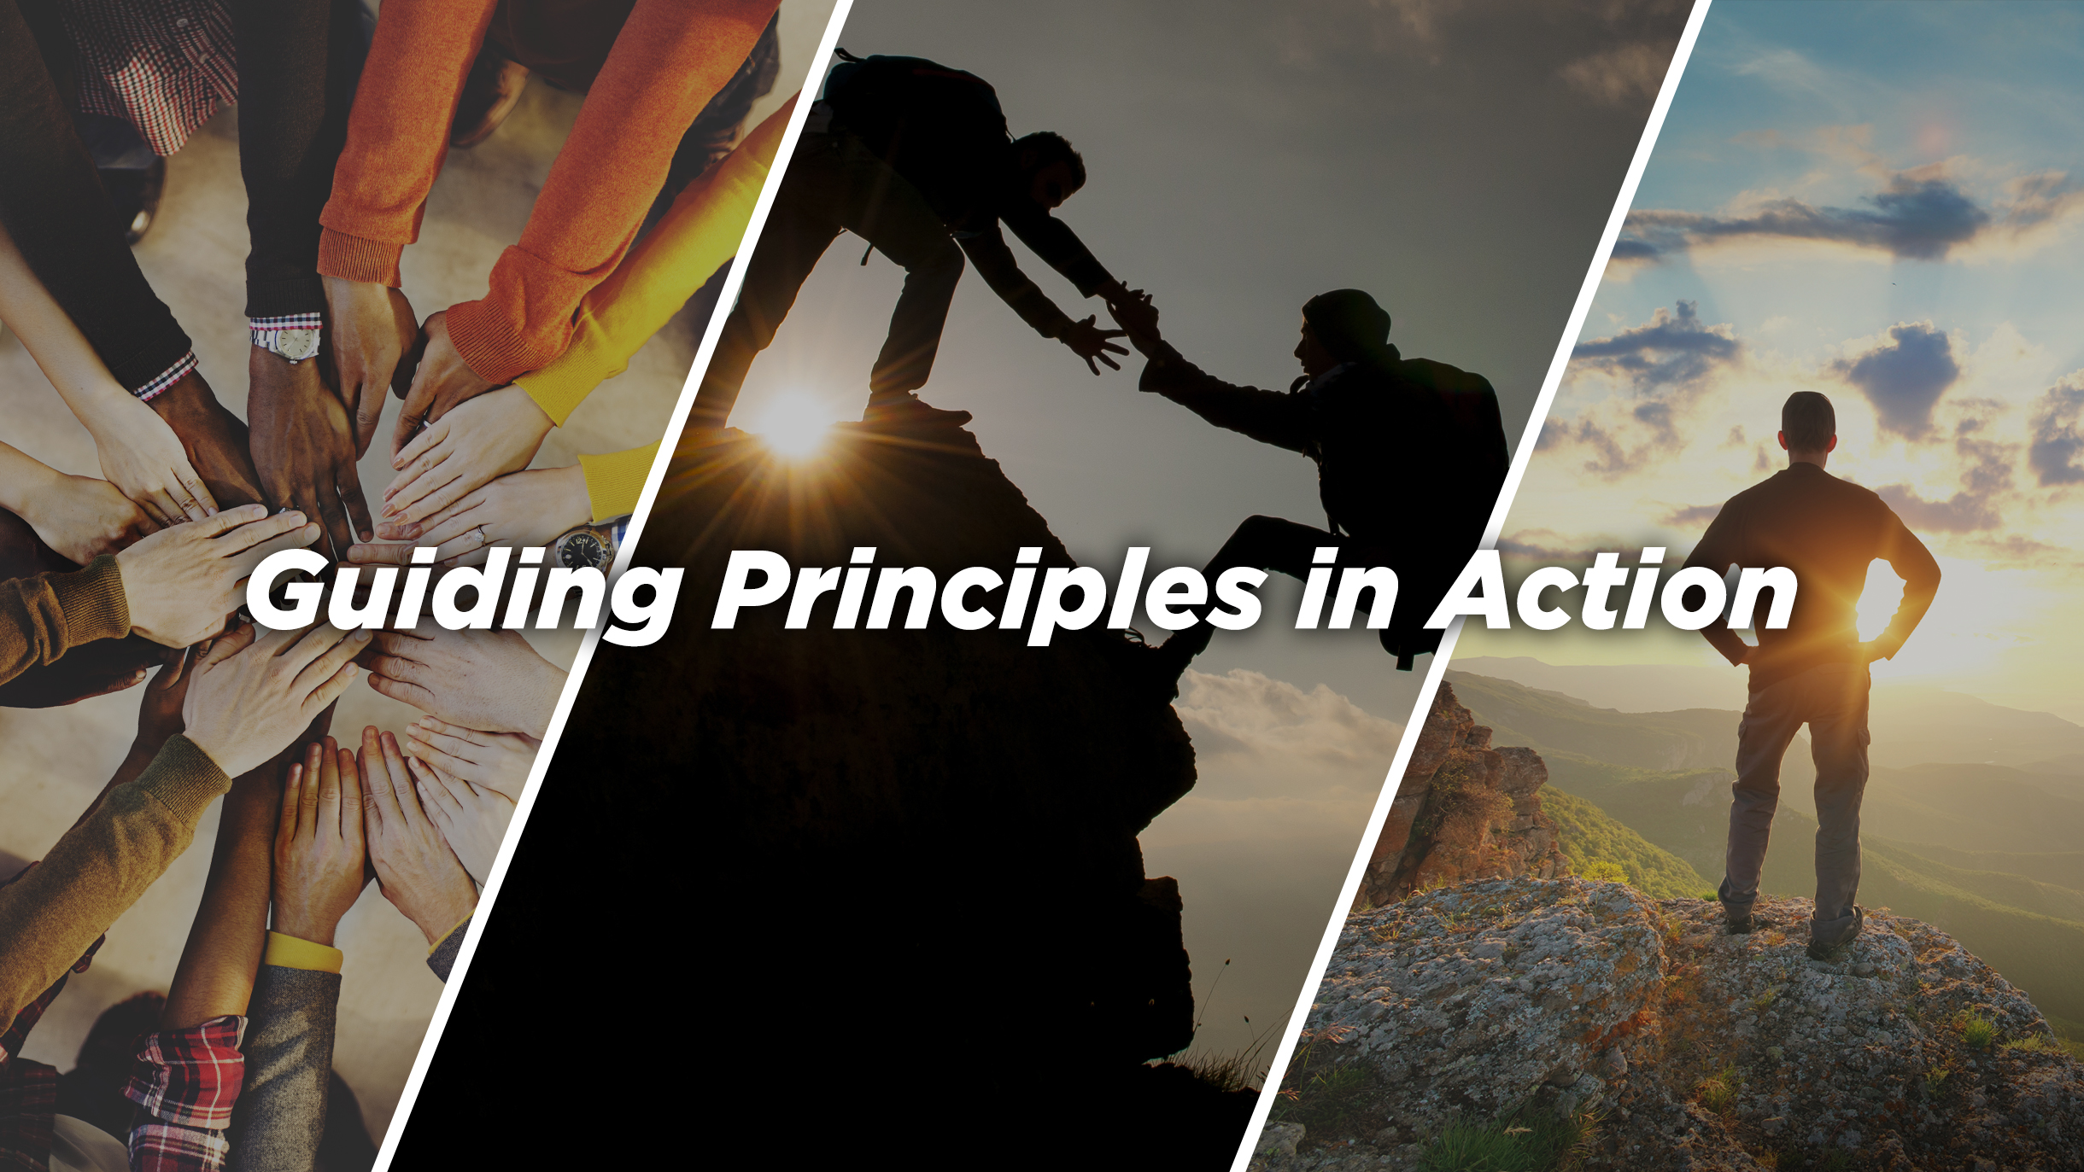

Slide 8

“Never stop doing little things for others. Sometimes those little thing occupy the biggest part of their hearts.”
-Author Unknown

Slide 9

What’s the best way to hit a target?
Notes:
What’s the best way to hit a target?
How you do align multiple teams to work together and deliver something efficiently and with quality?

Slide 10

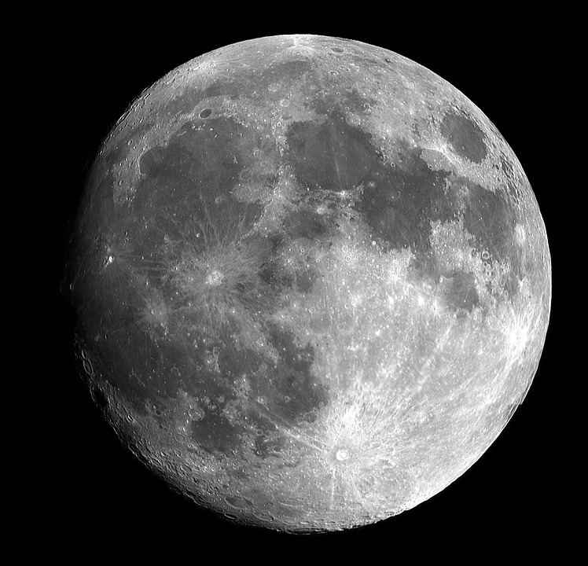
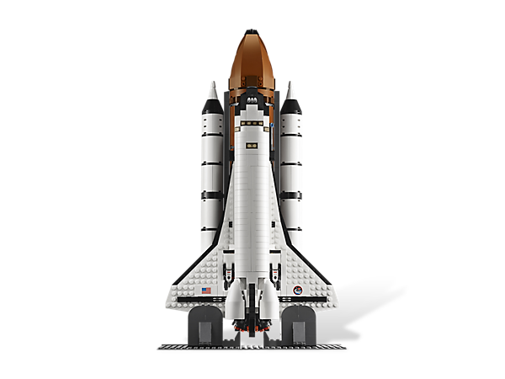
Option #1
Calculate route at the beginning
Burn minimal fuel
Risk:
Emergency course adjustment at the end of the journey
Burn a lot of fuel
Execution Level:
Easy
Notes:
When NASA was preparing to travel to the moon they discussed 2 potential paths:
Build a one-engine ship with a navigation system that would calculate the path at the beginning of the journey and set them on their way. This would allow them to burn as little fuel as possible along the journey and still allow to hit their target – the moon.
The risk was that they could find themselves off target only when they almost arrived at the moon and would require an emergency course correction which would require a lot more fuel, and could risk their ability to get back to Earth.

Slide 11
Option #2
Correct course along the way
Risk:
Minimized
Execution Level:
Difficult
Notes:
Option #2
They could build a more powerful ship with more fuel, which would be more difficult to build. But it would allow them to build a more sophisticated navigation system so they could adjust their course along the way, minimizing the risk of hitting their target – the moon.

Slide 12
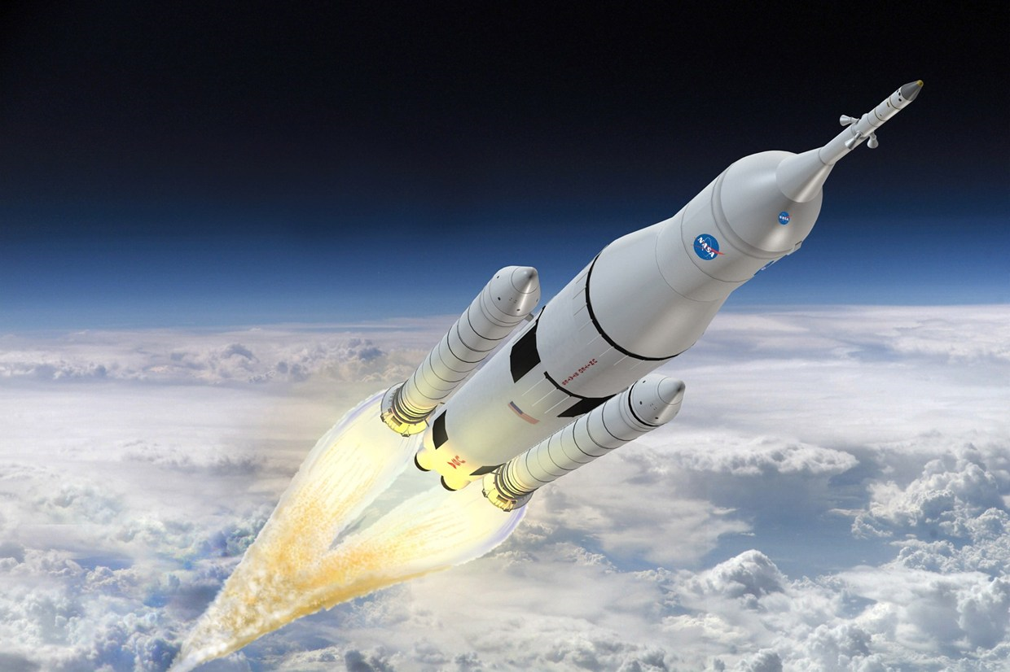

E-COMMERCE REVIEW
Product Innovation choose option #2 and
built a powerful ship with our 3 super engines
AVI WISBERG
JANUARY 2017
PRAS
MICROFACTORY
INCUBATION
Notes:
We recently completed the first stage of the Automatable Cartridge project and we needed the involved of 3 teams:
1) Product Incubation - design the cartridge
2) PRAS – Analytical tests for cartridge and give feedback
3) Micro Factory - provide the parts and build the cartridges for testing
We built a power 3 engine ship to enable us to achieve our goal.

Slide 13
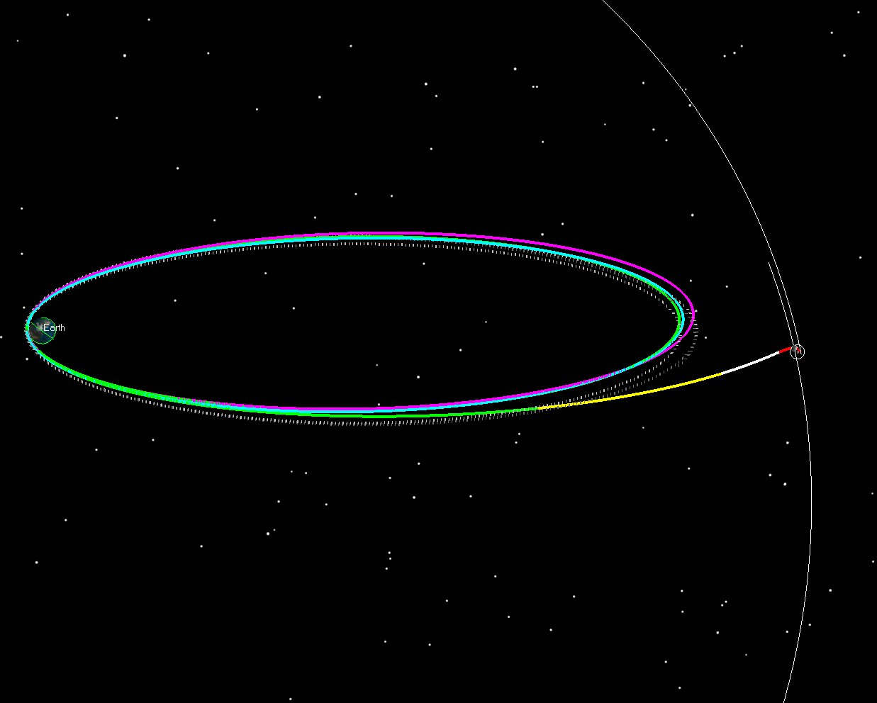
Marketing
It wasn’t easy to get the ship moving in the right direction…
Making it work globally
PRAS
MICROFACTORY
PRODUCT INCUBATION
Notes:
It took us time to learn how to collaborate between the teams

Slide 14
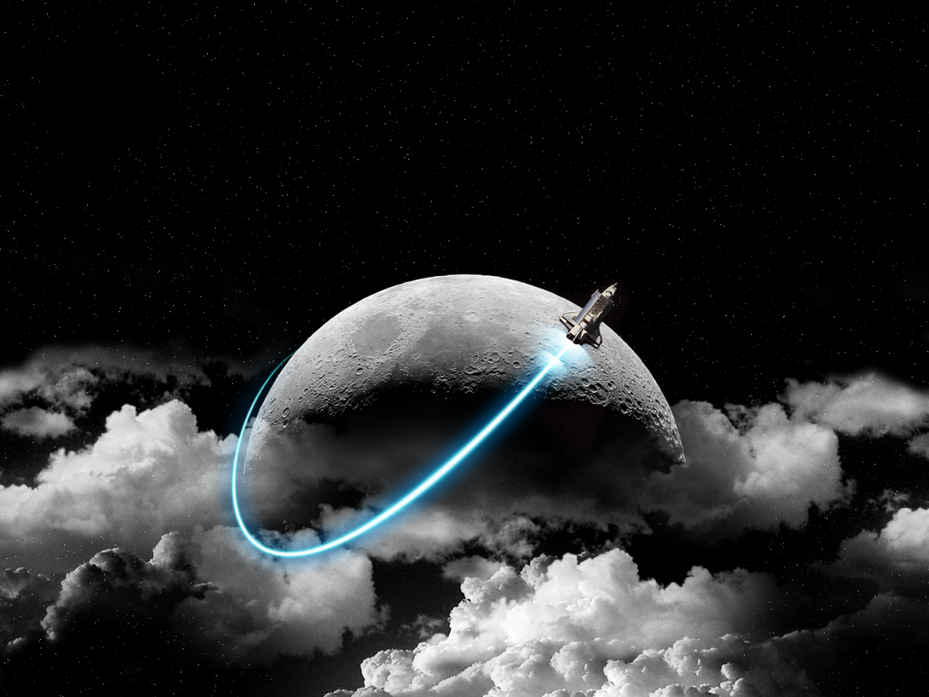
E-Commerce Review
But we worked together as a team and reached our destination!
Notes:
But we worked together as a team and reached our destination!

Slide 15
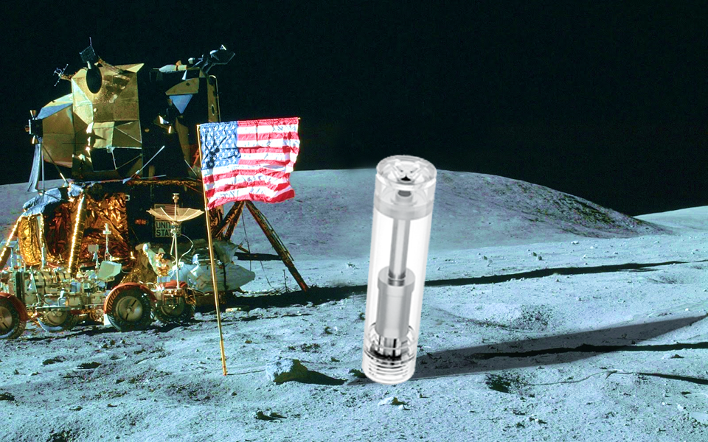
Working together the teams achieved a tremendous amount in a very short span of time, and we achieved our goal!
Hi, I’m an automatable cartridge…and I’m on the moon!
Notes:
Working together the teams achieved a tremendous amount in a very short span of time, and I’m happy to say that we achieved our goal!

Slide 16
Collaborating together and aligning as a united team, is without a doubt the best way to achieve any goal we set out for ourselves.
Notes:
Collaborating together and aligning as a united team, is without a doubt the best way to achieve any goal we set out for ourselves.

Slide 17
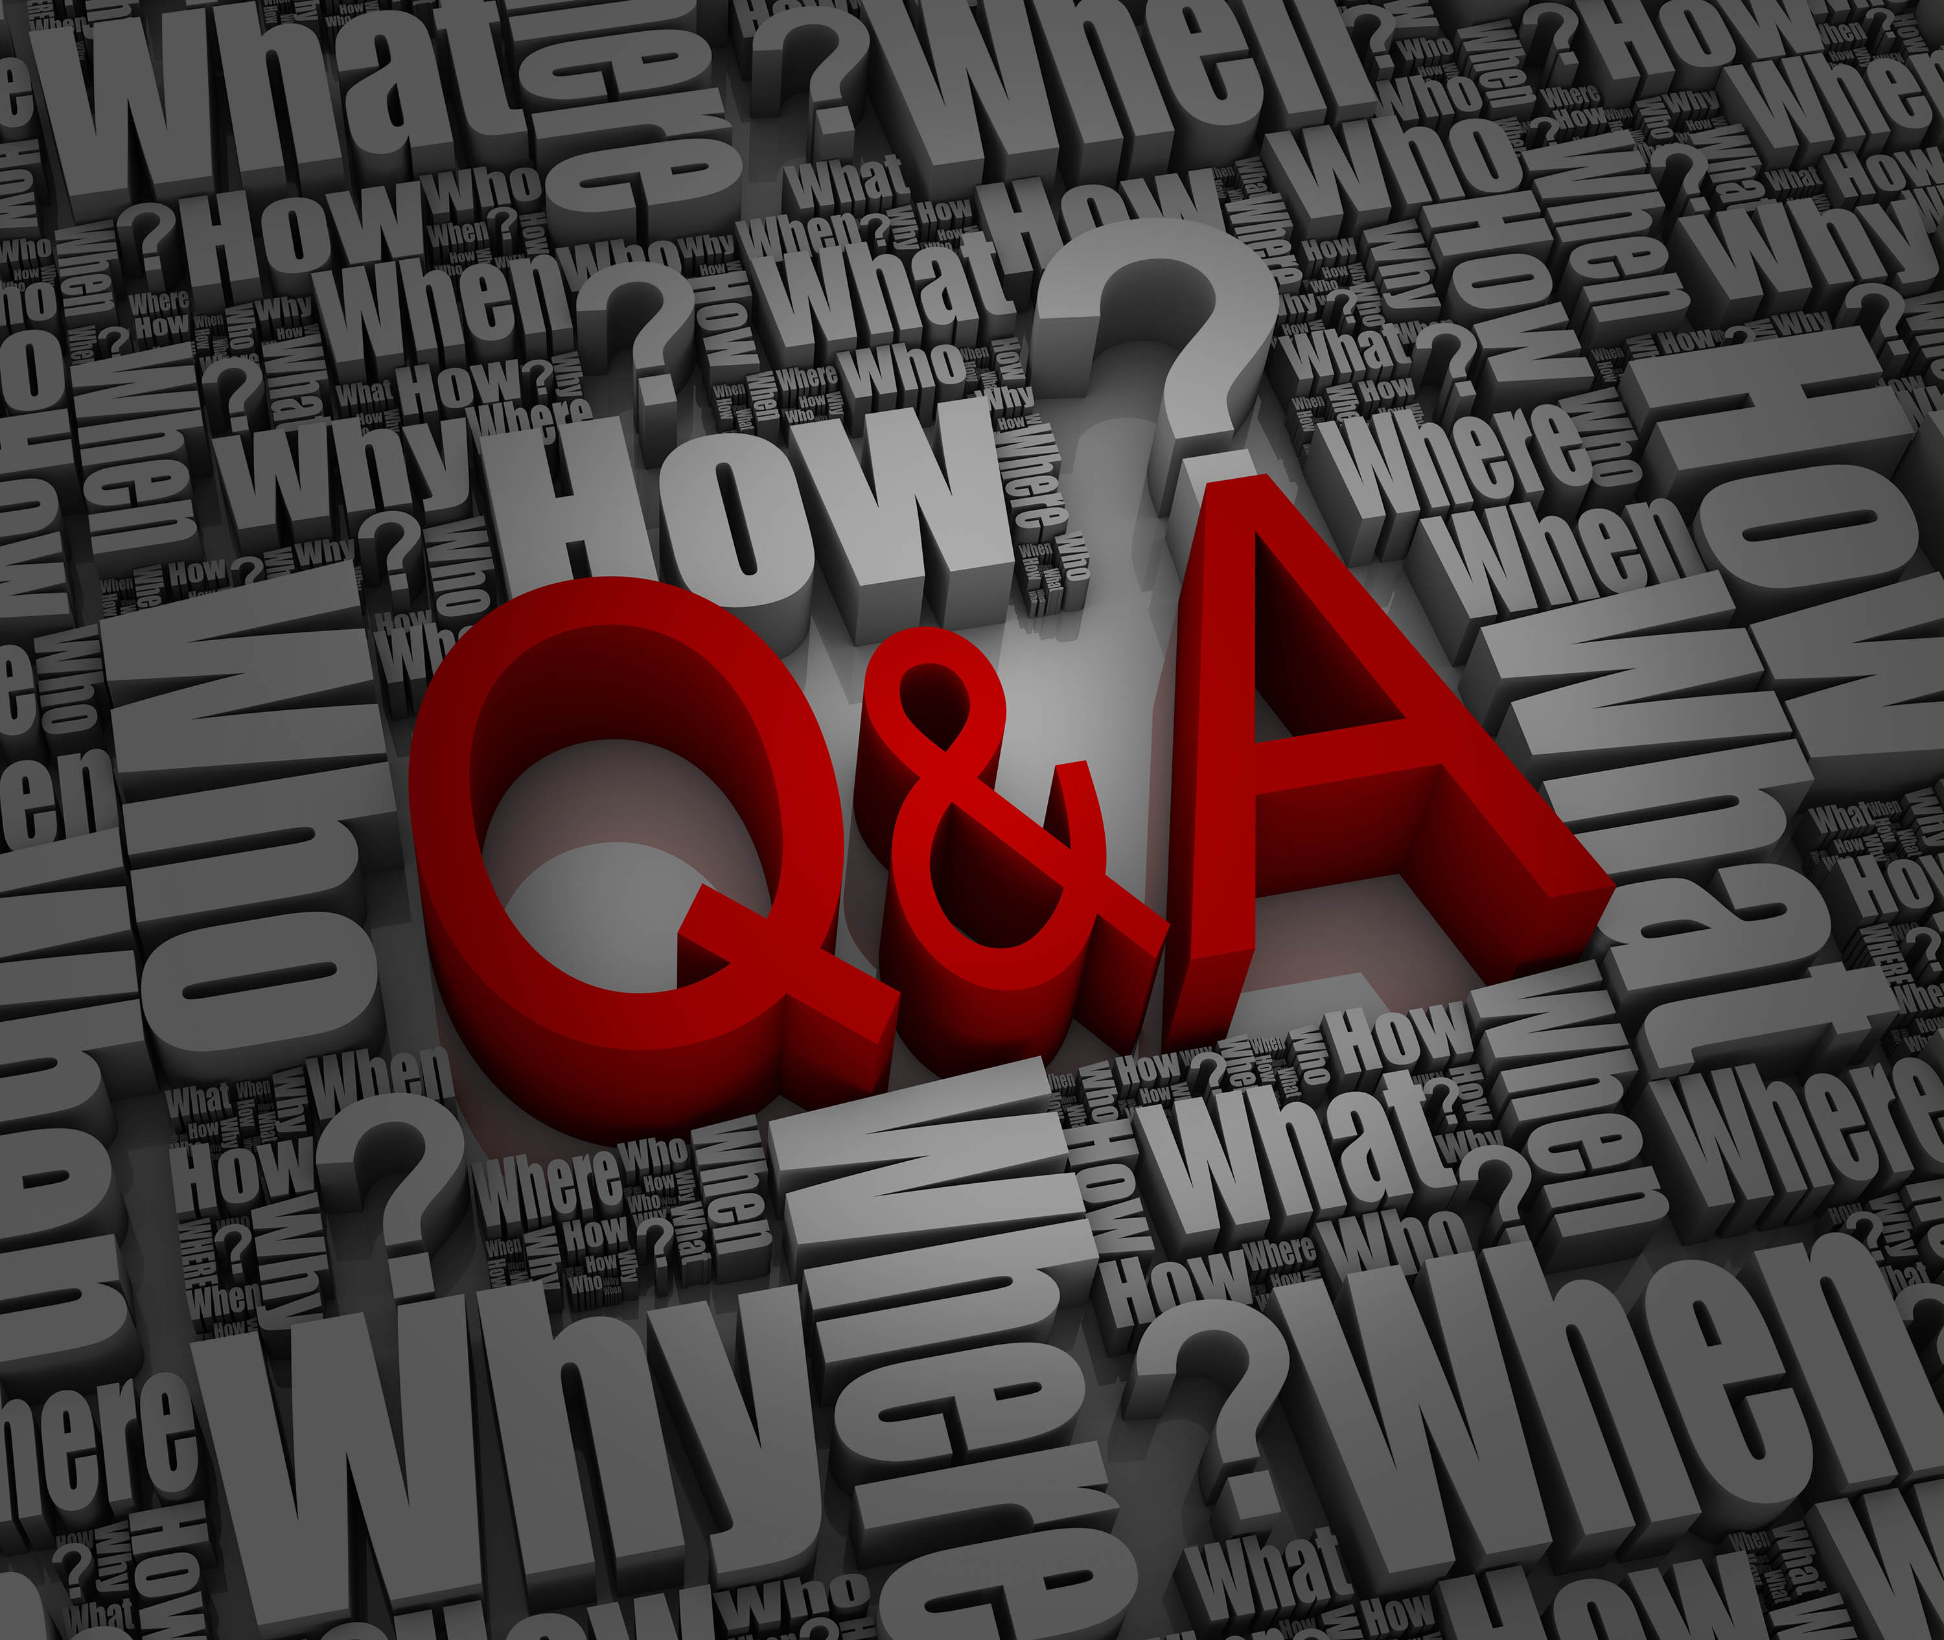


Slide 18


Slide 19



Slide 20
Tzirel Shaffren
QA Engineer

Slide 21
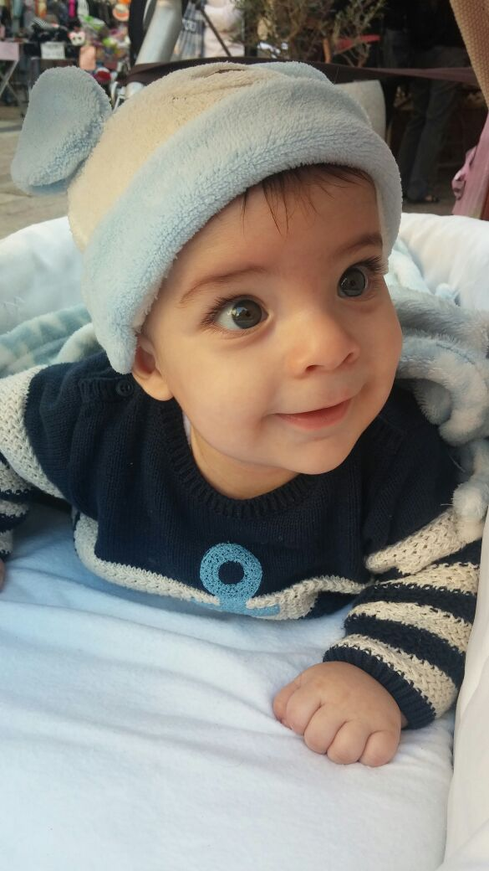

Slide 22
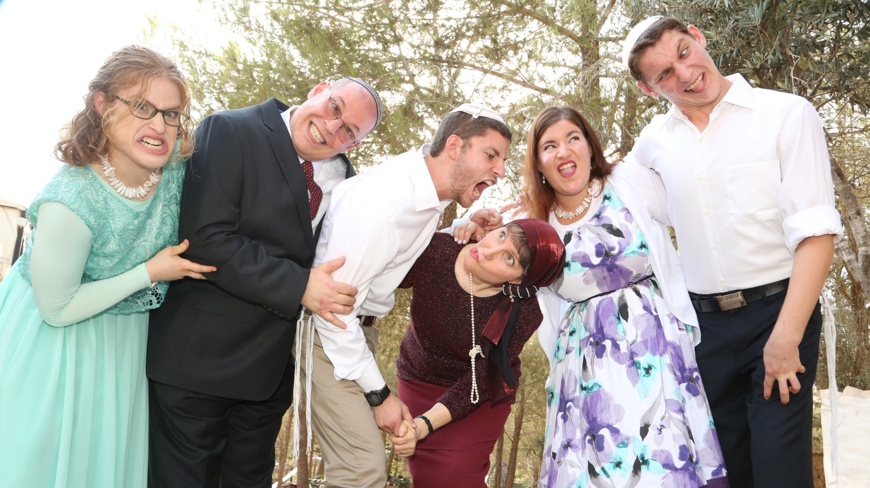

Slide 23
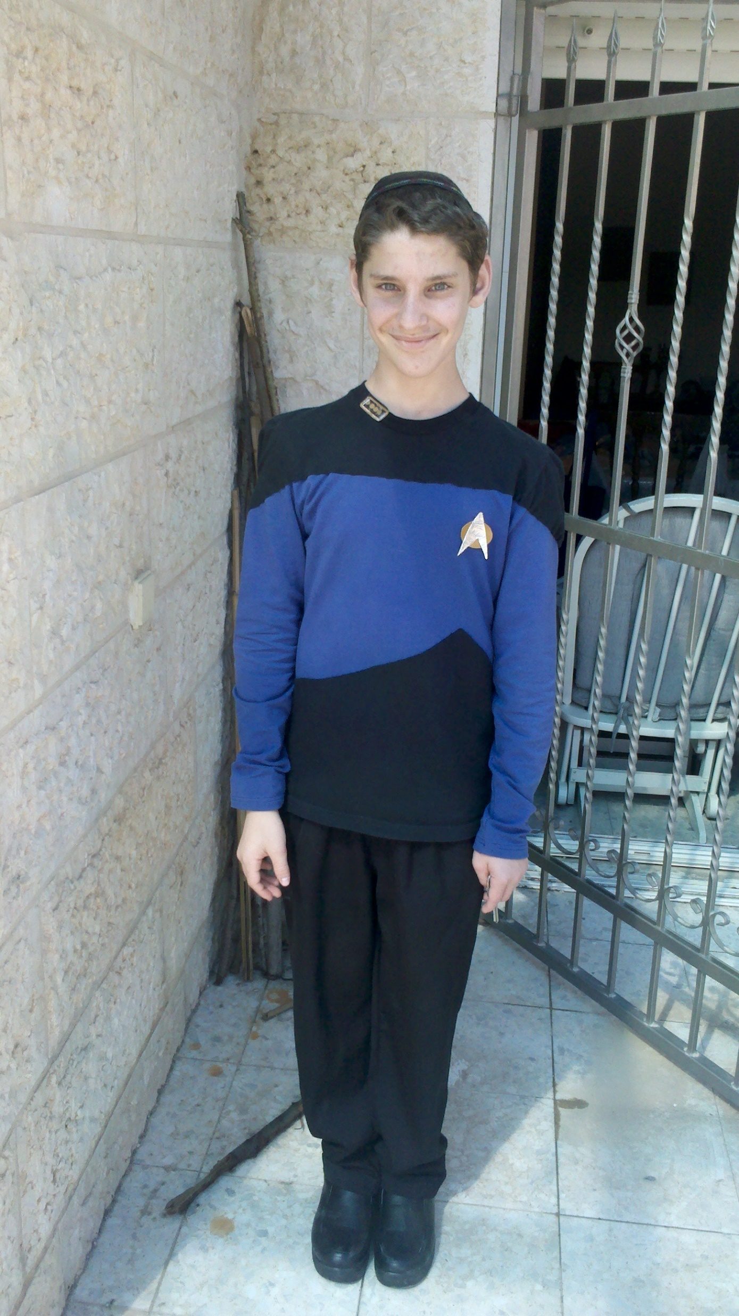
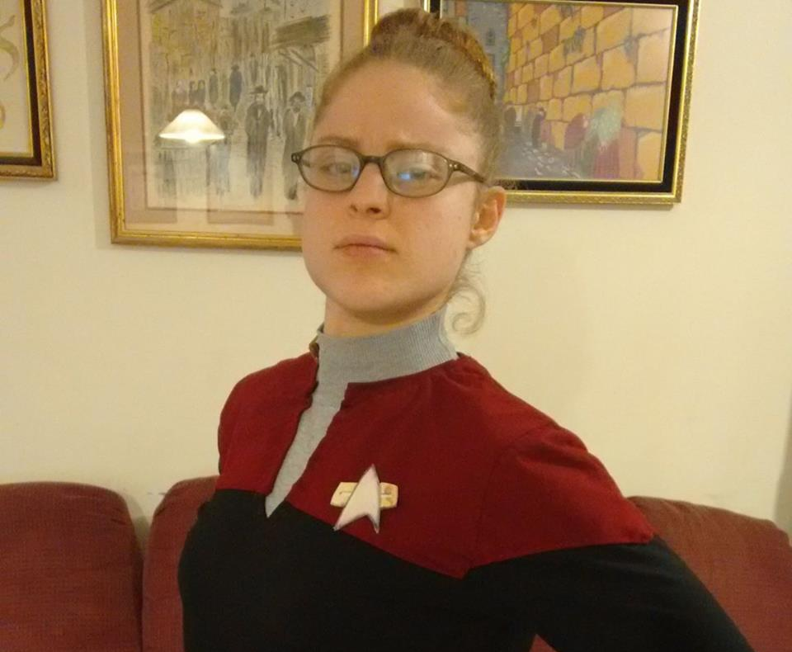

Slide 24
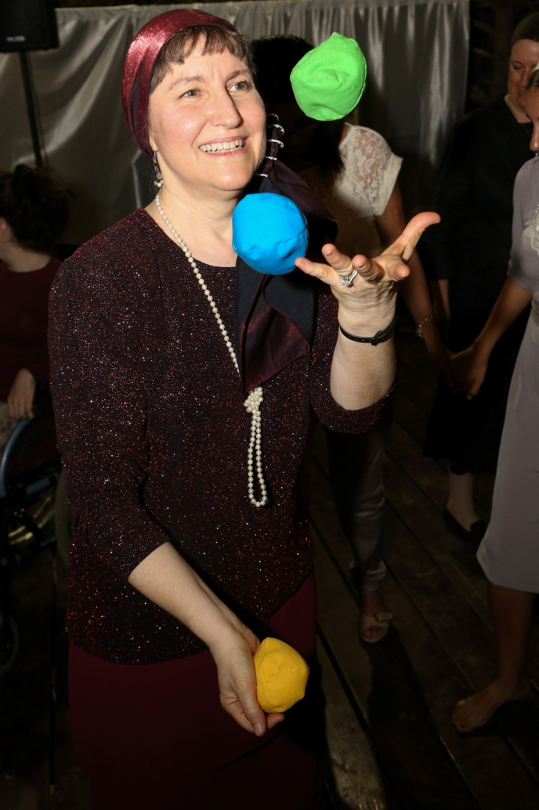

Slide 26
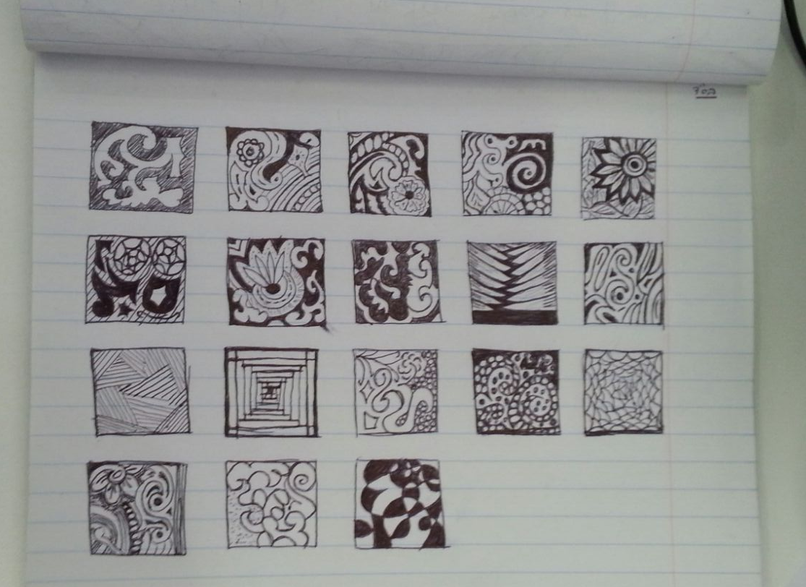
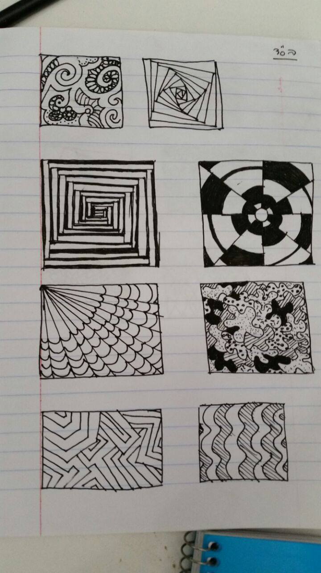
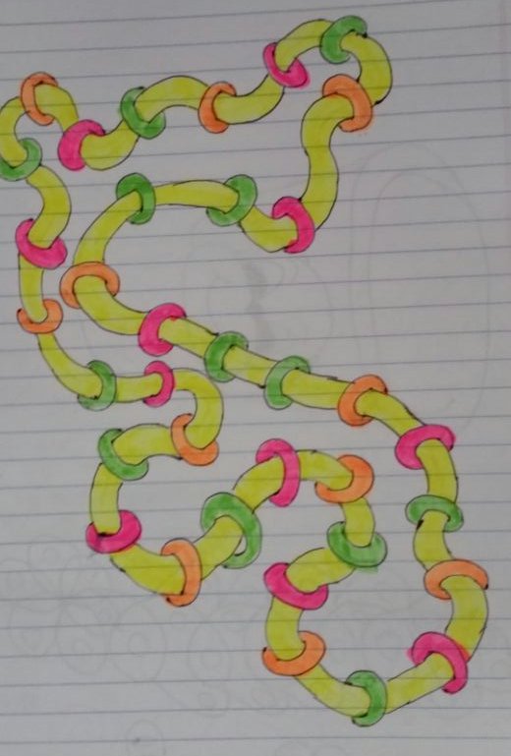
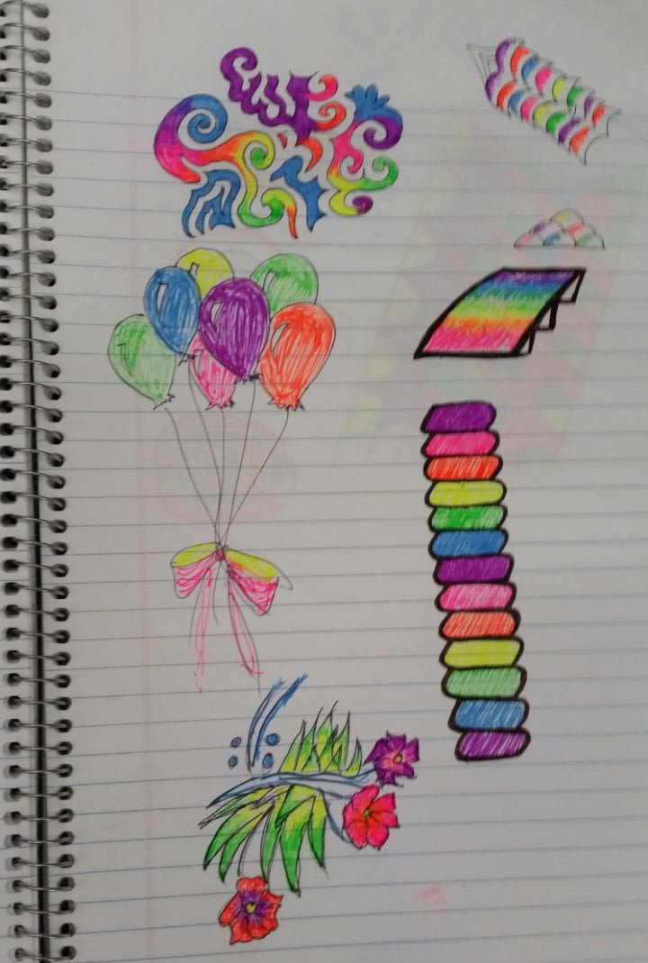
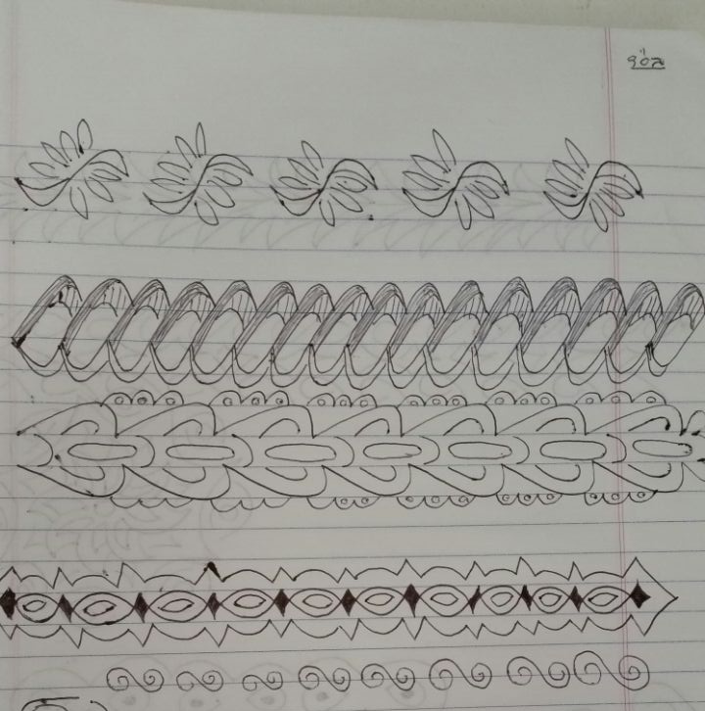
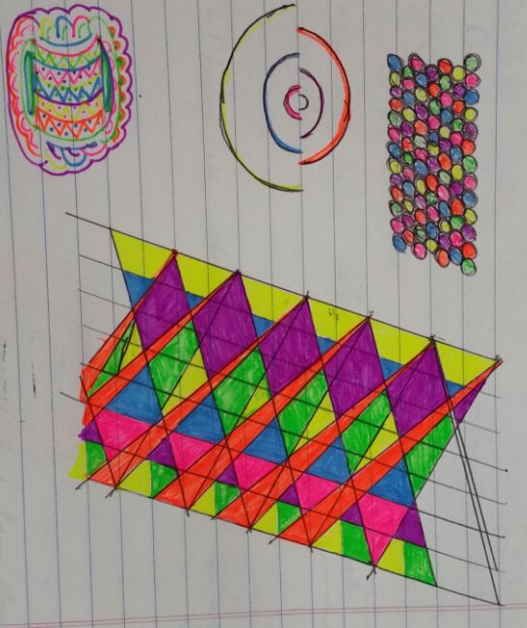
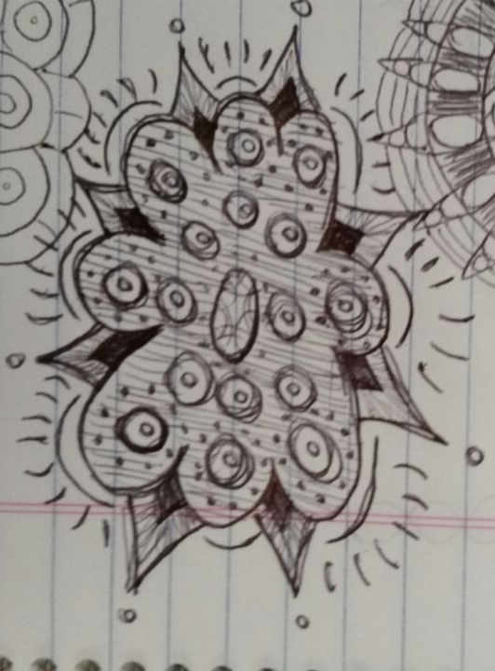
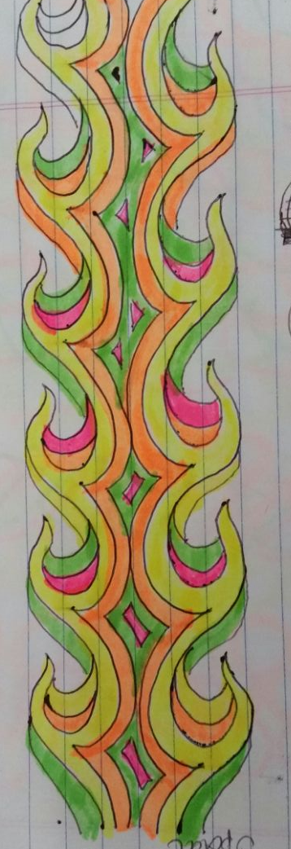

Slide 27
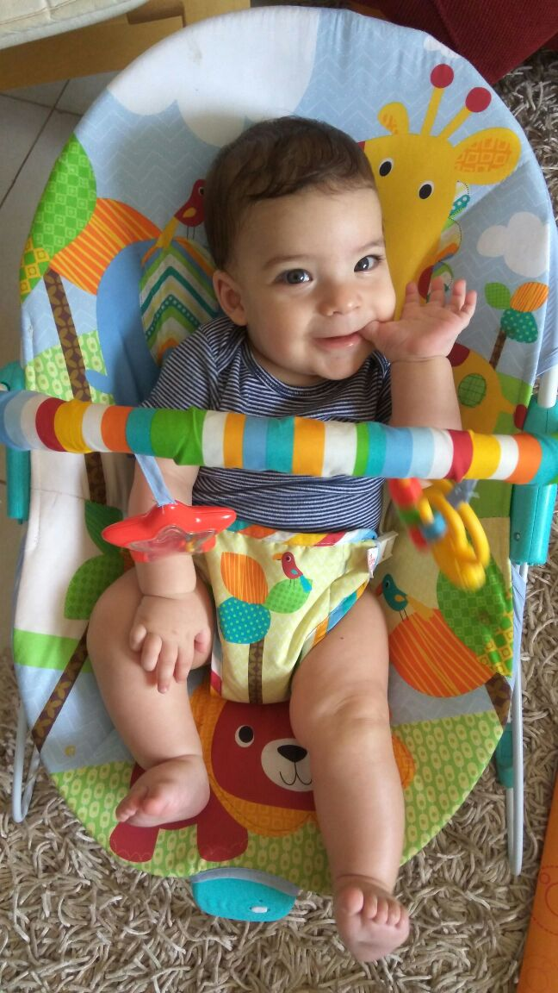

Slide 28
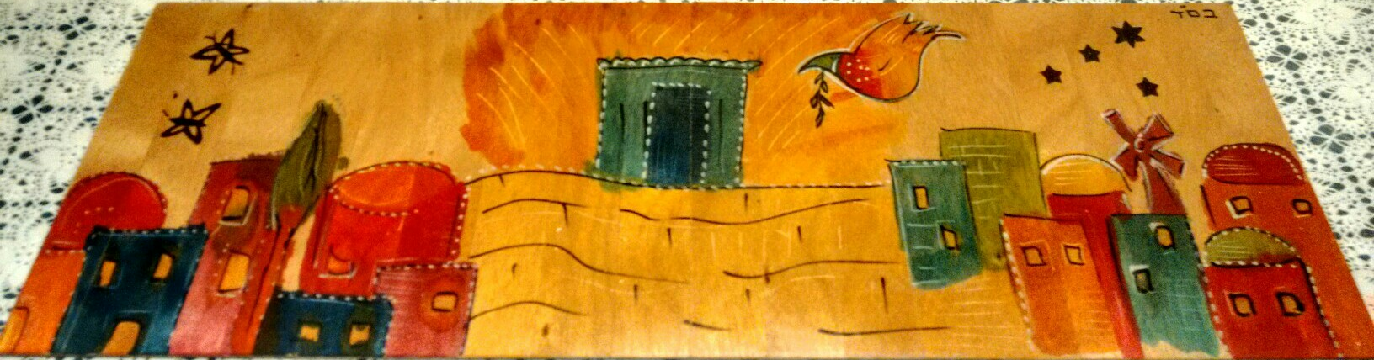
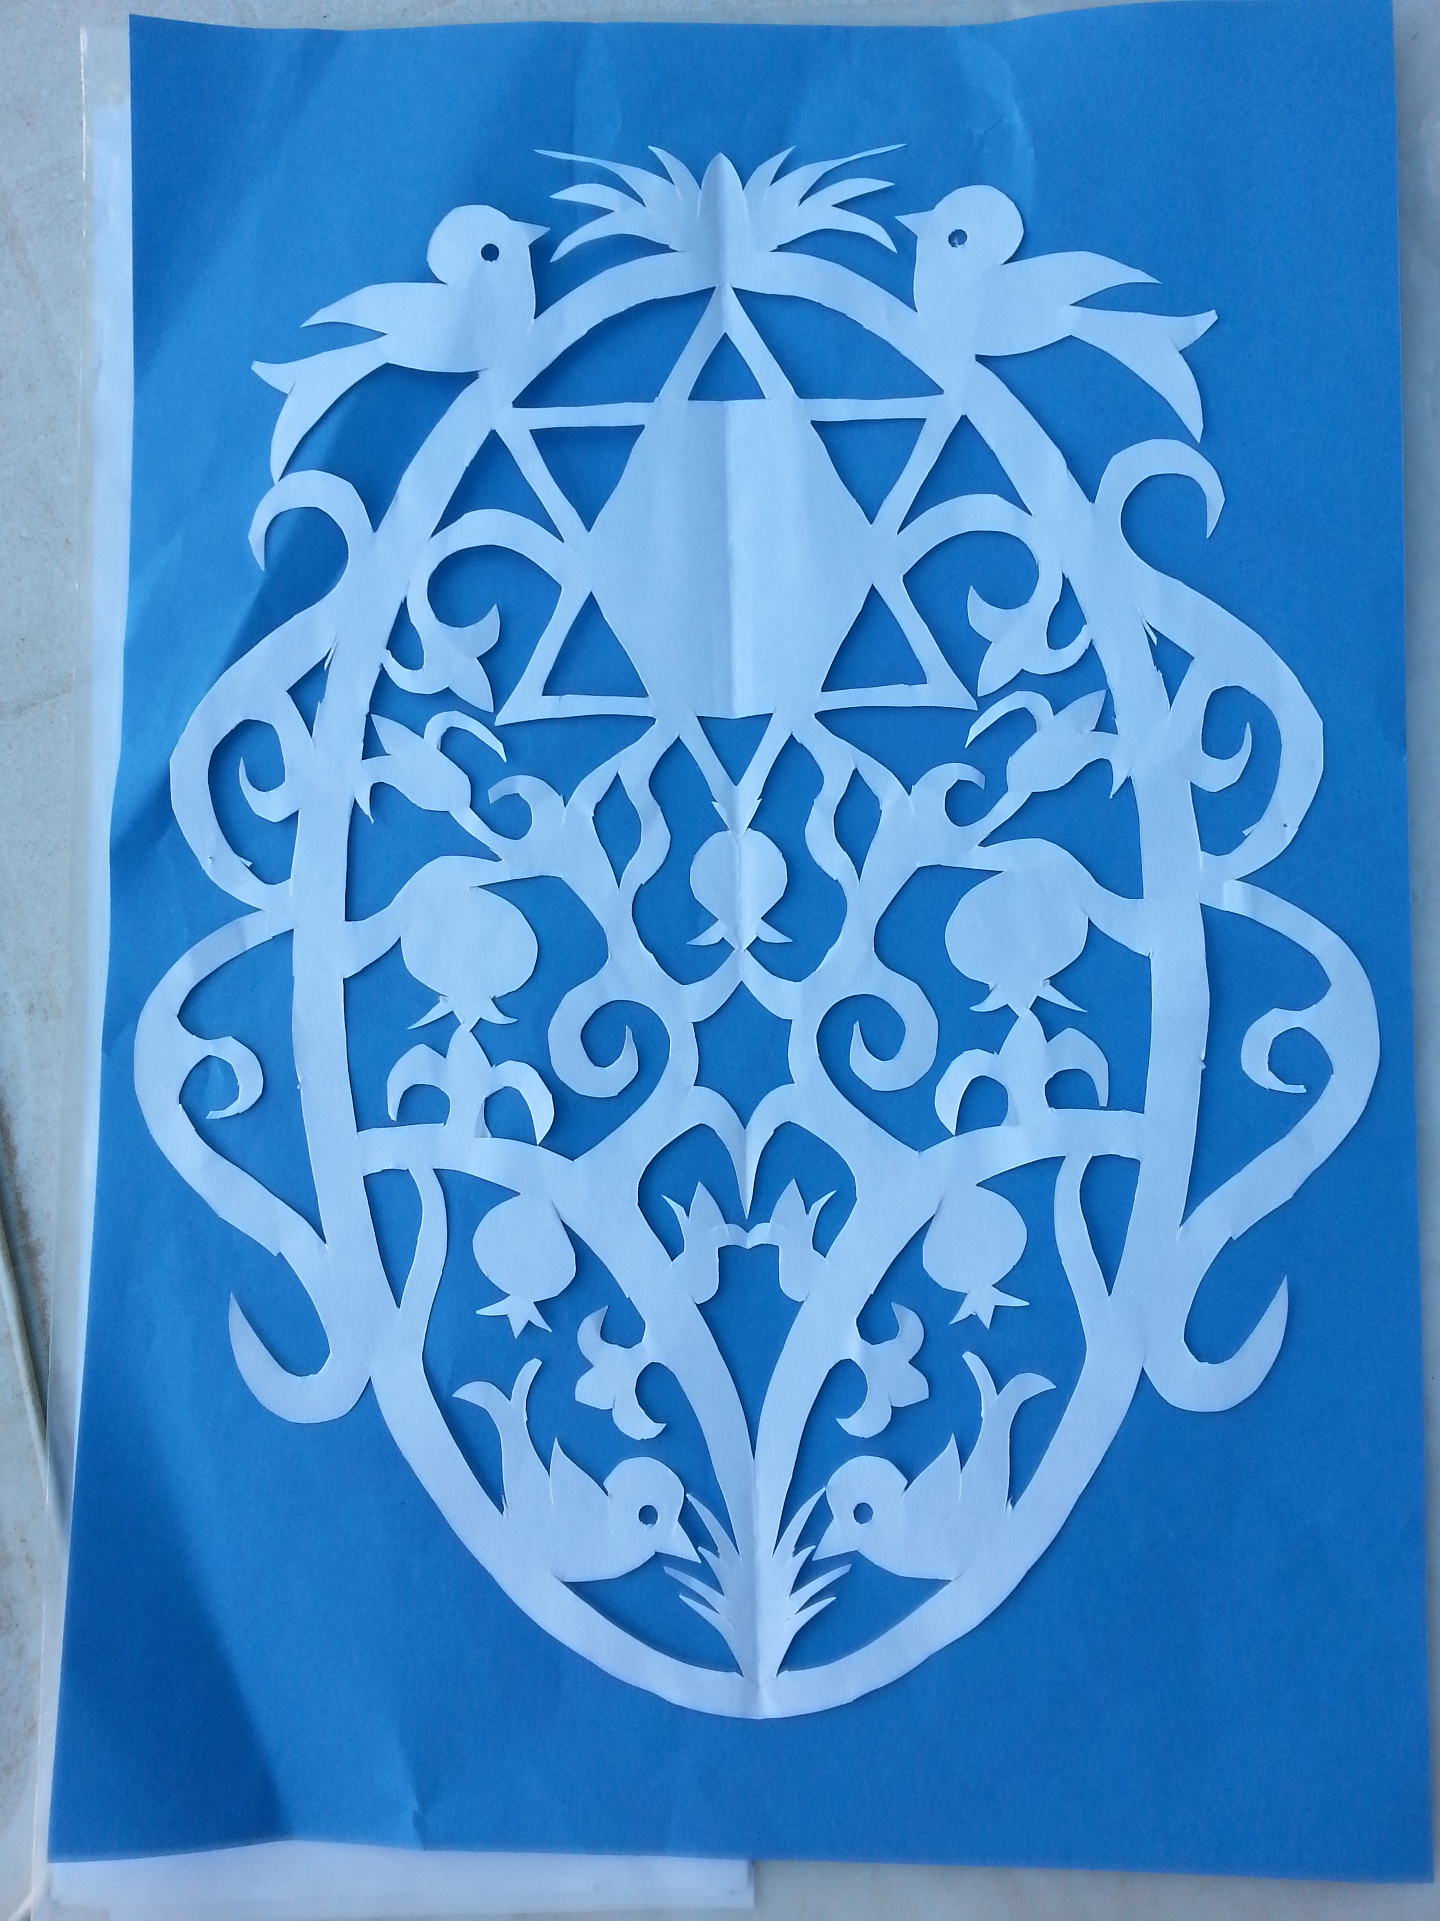
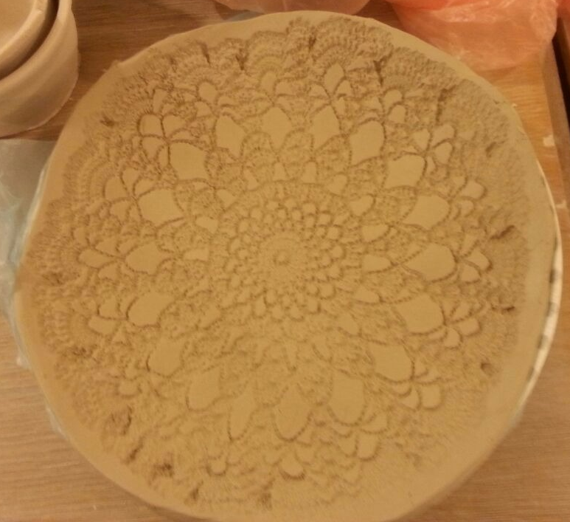
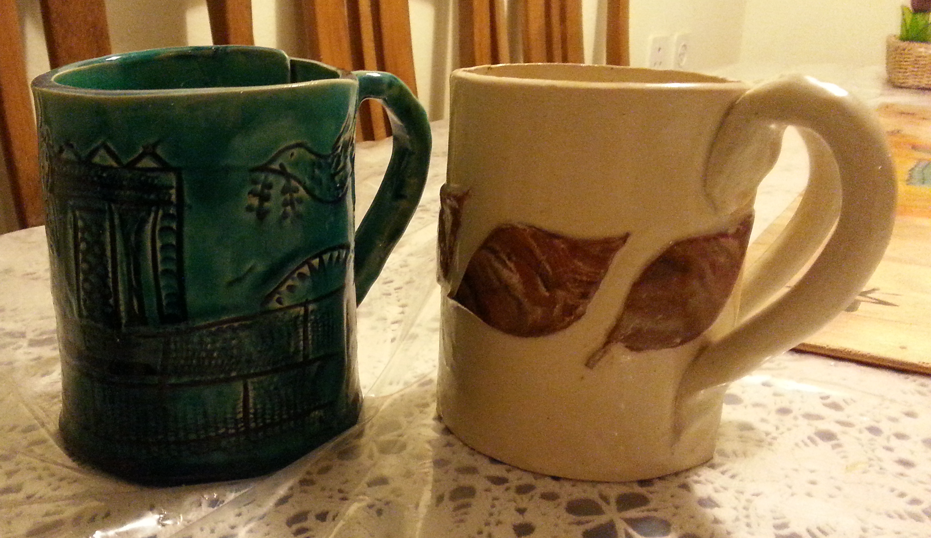
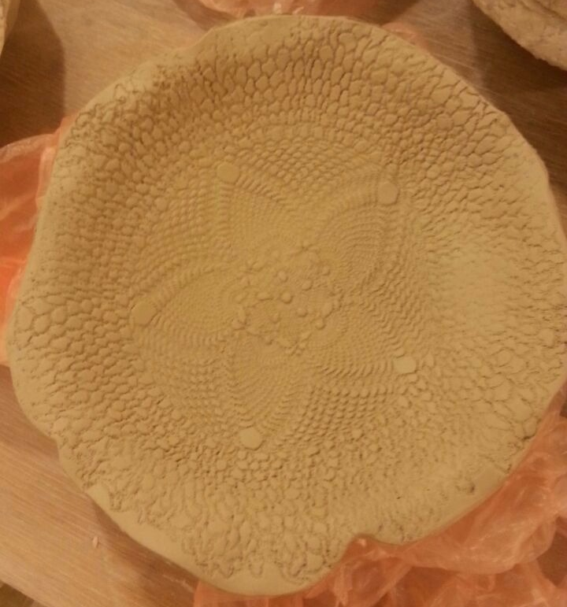
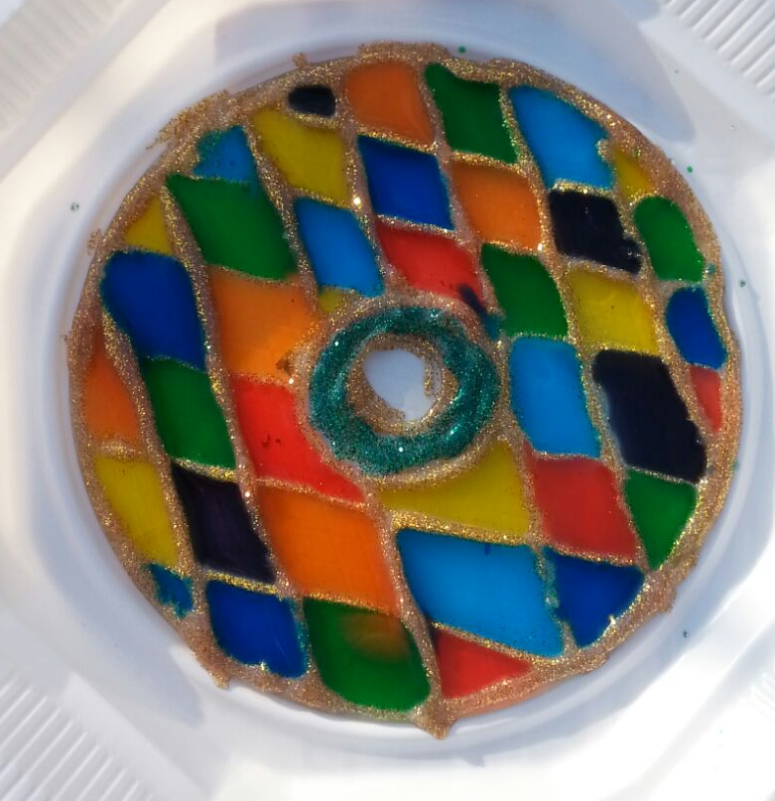
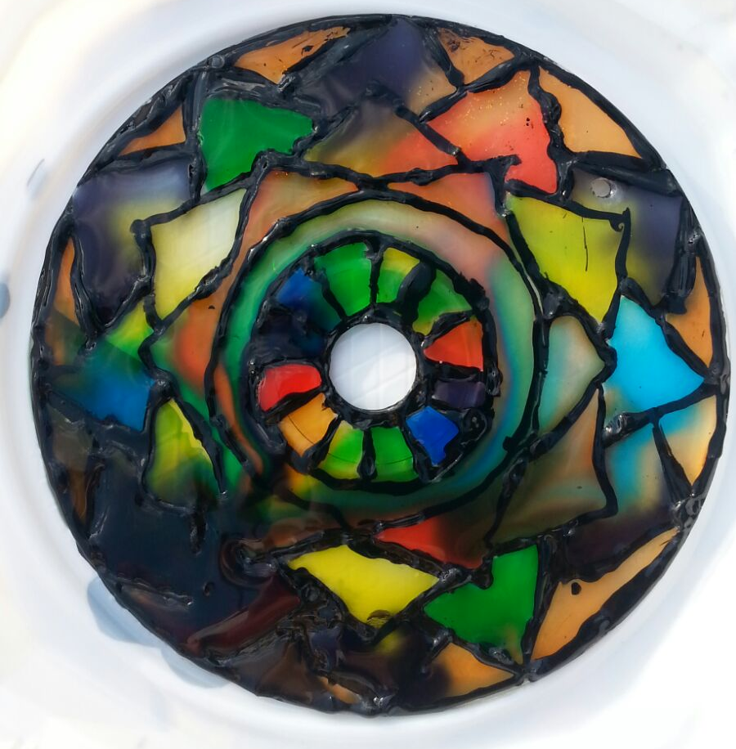
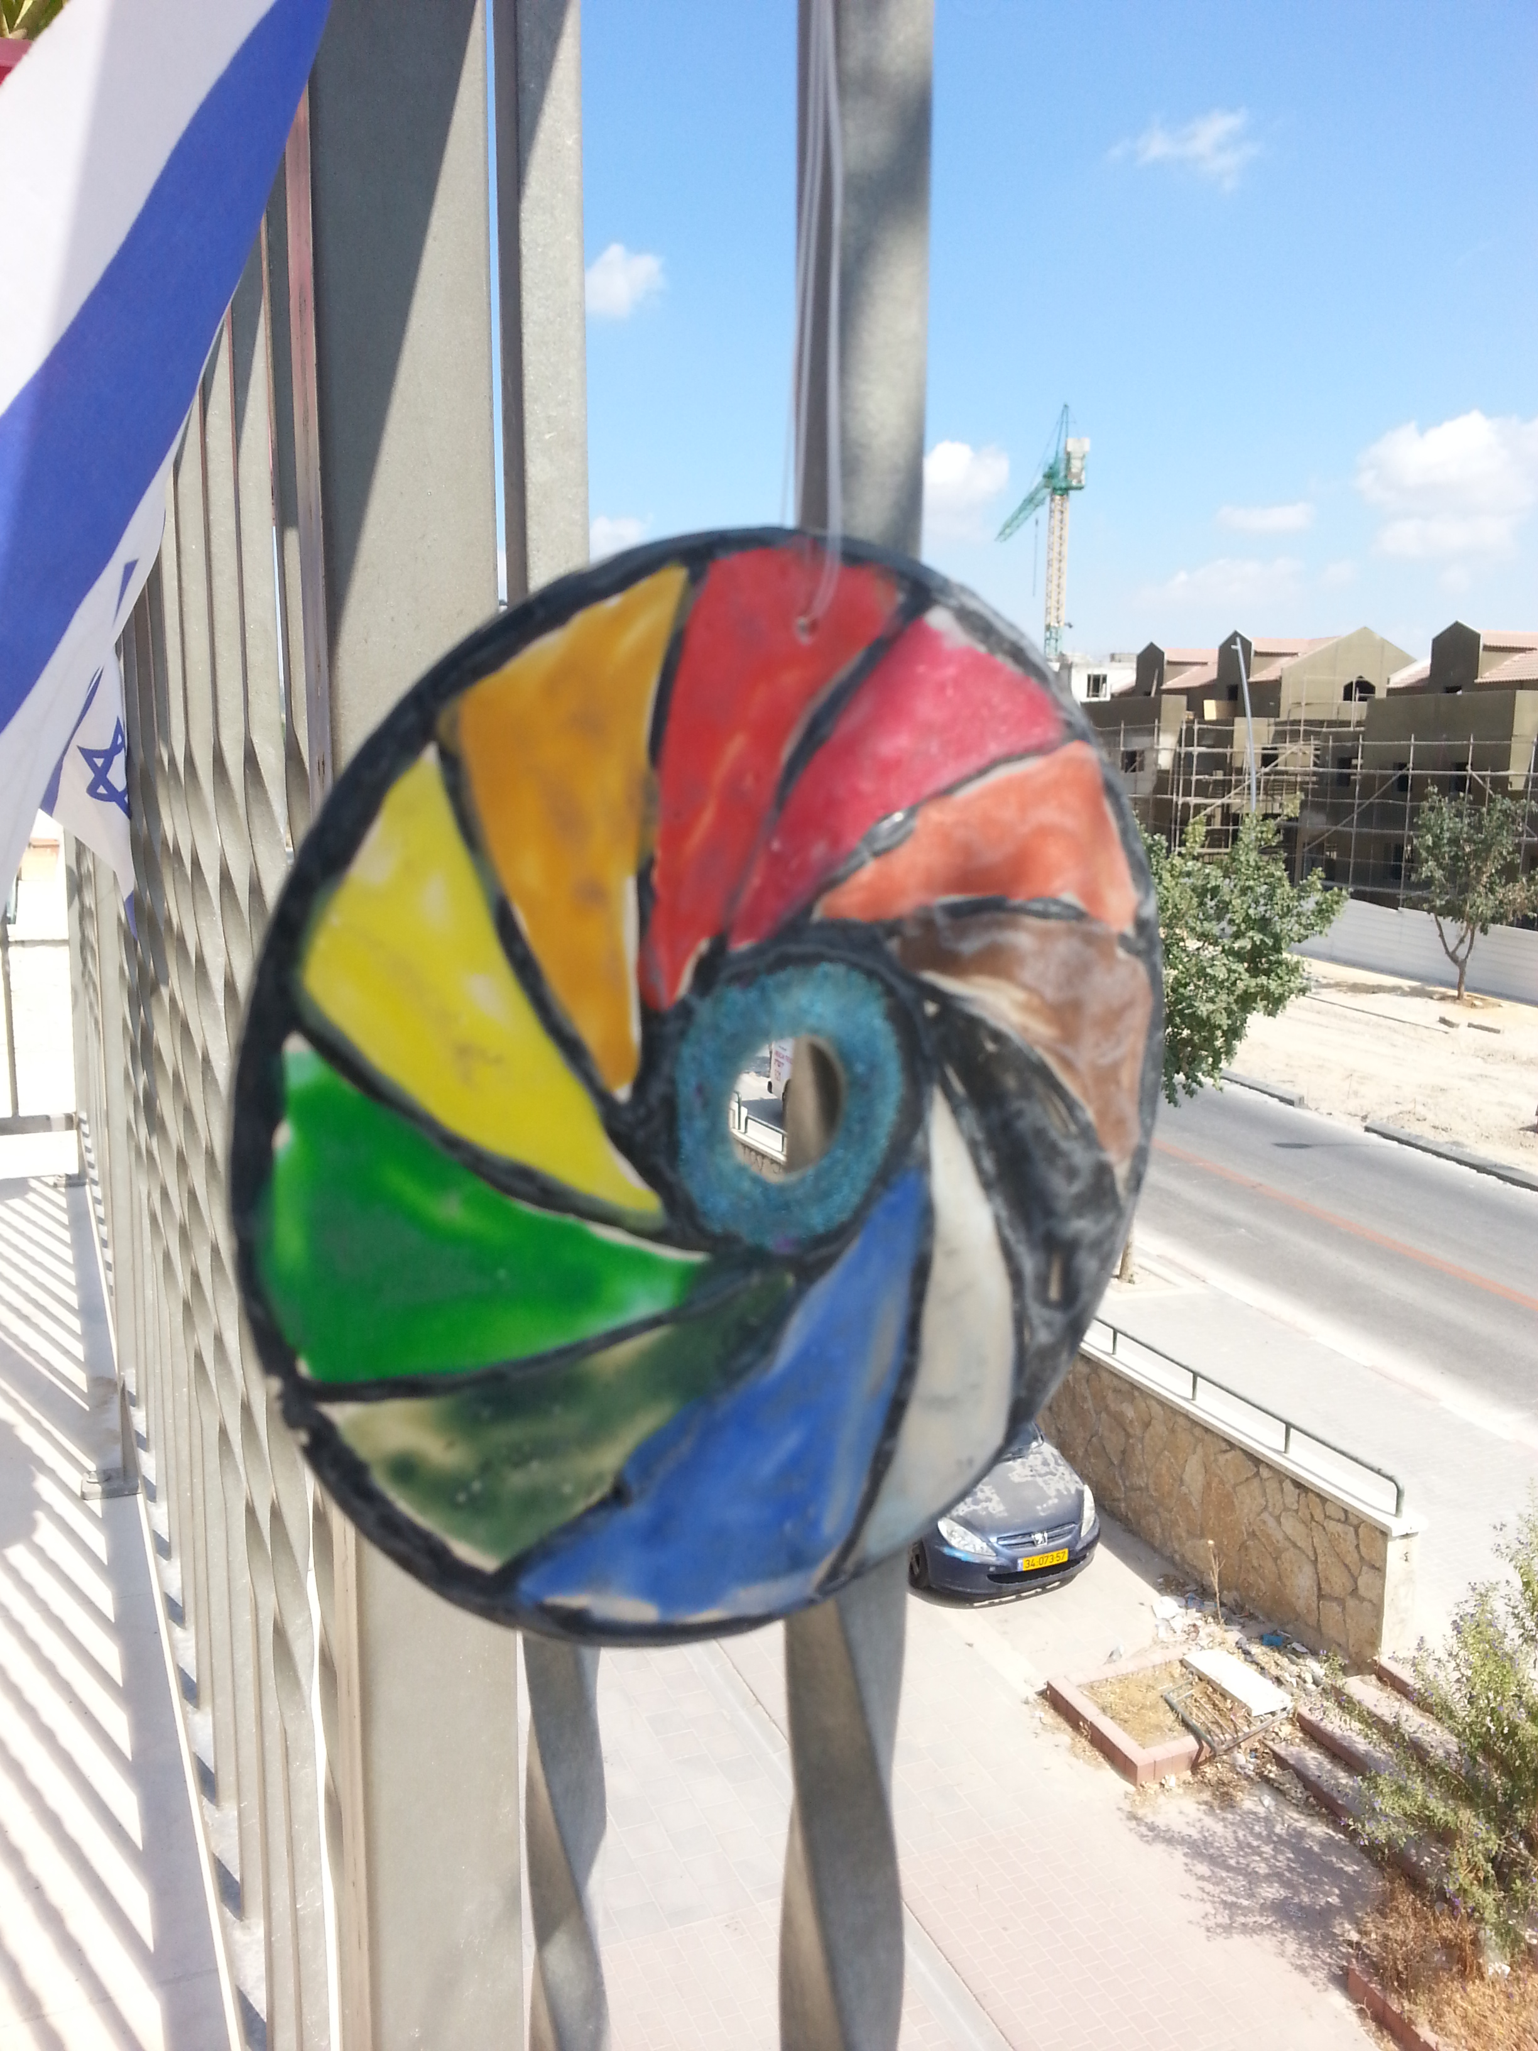
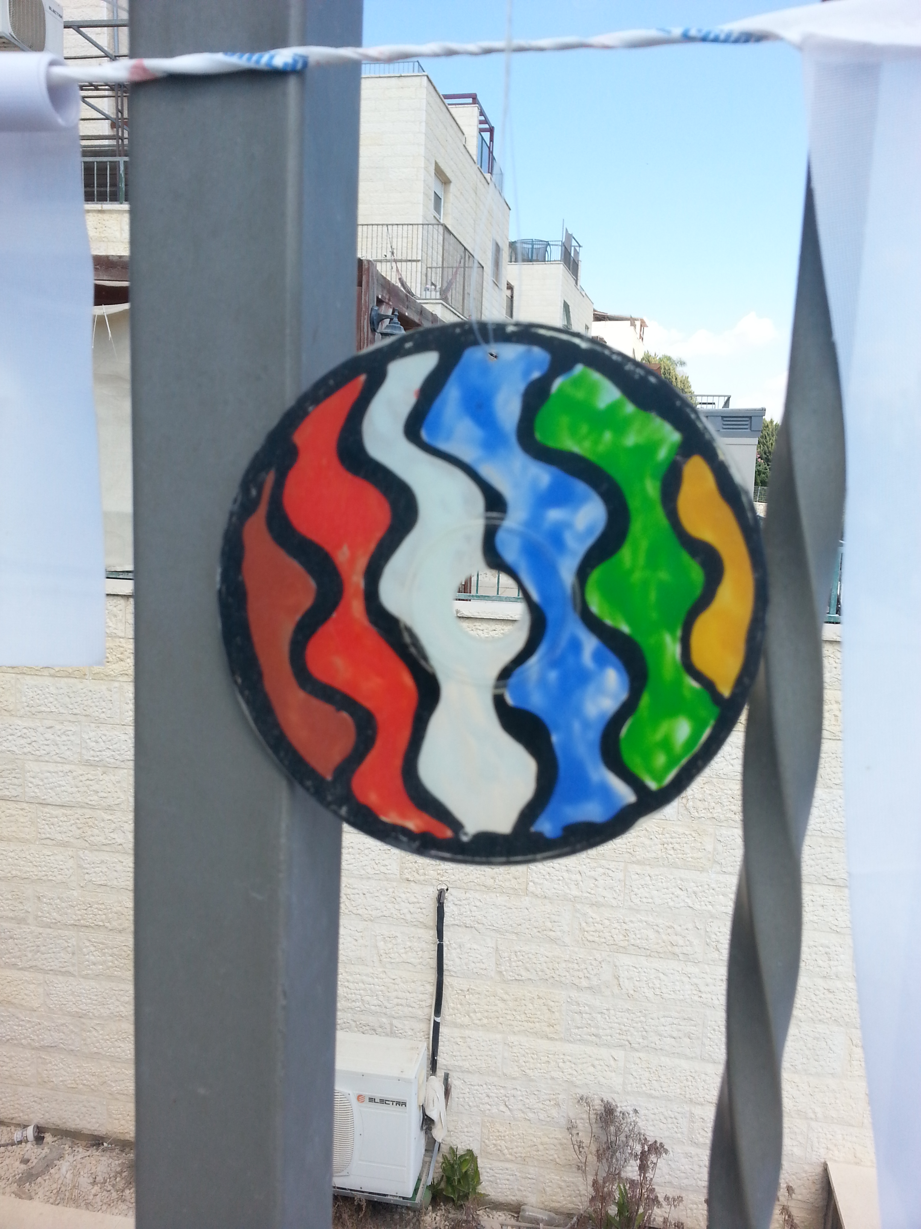

Slide 29
Adults can’t think as stupid as kids’ll do

Slide 30
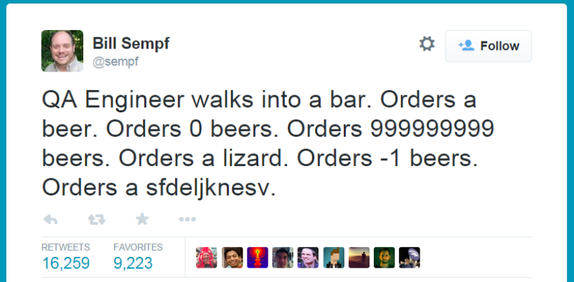
What is QA

Slide 31
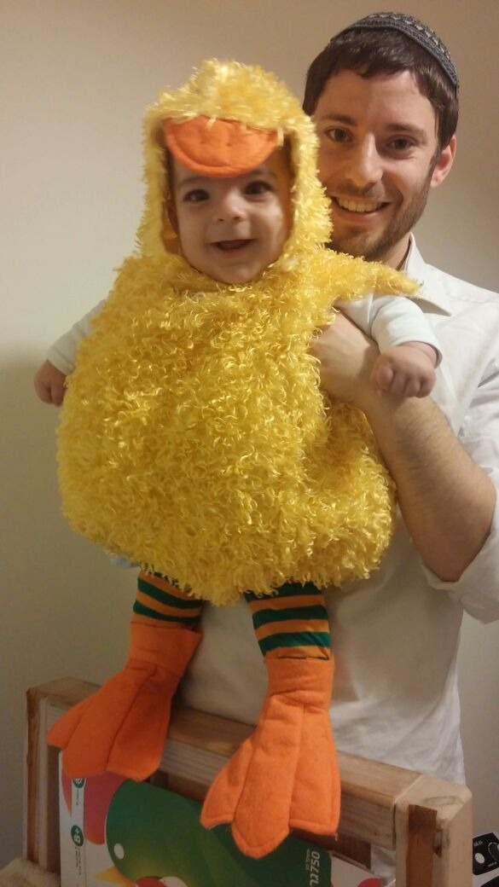

Slide 32
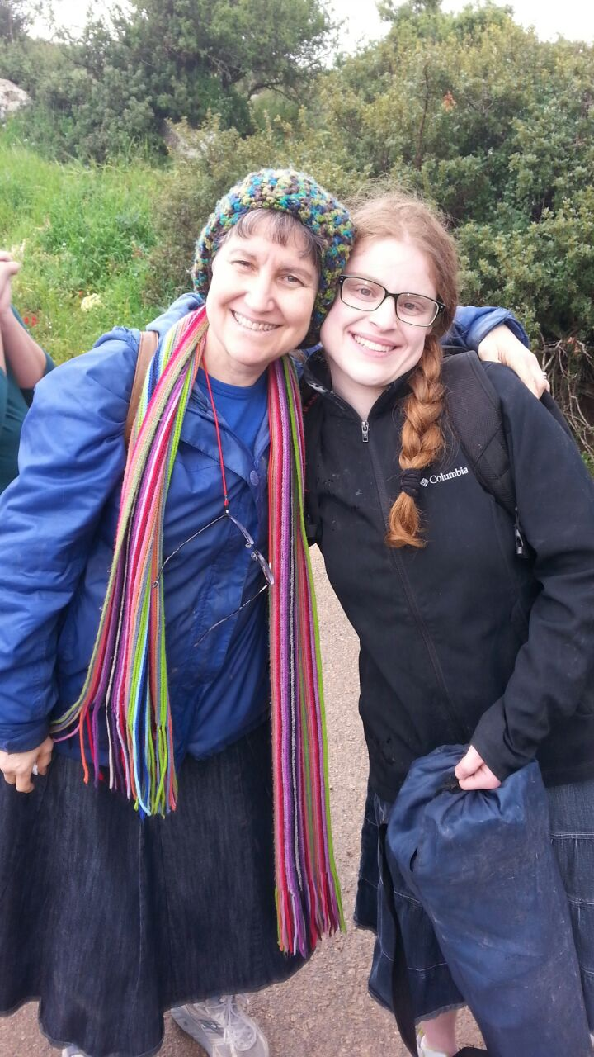
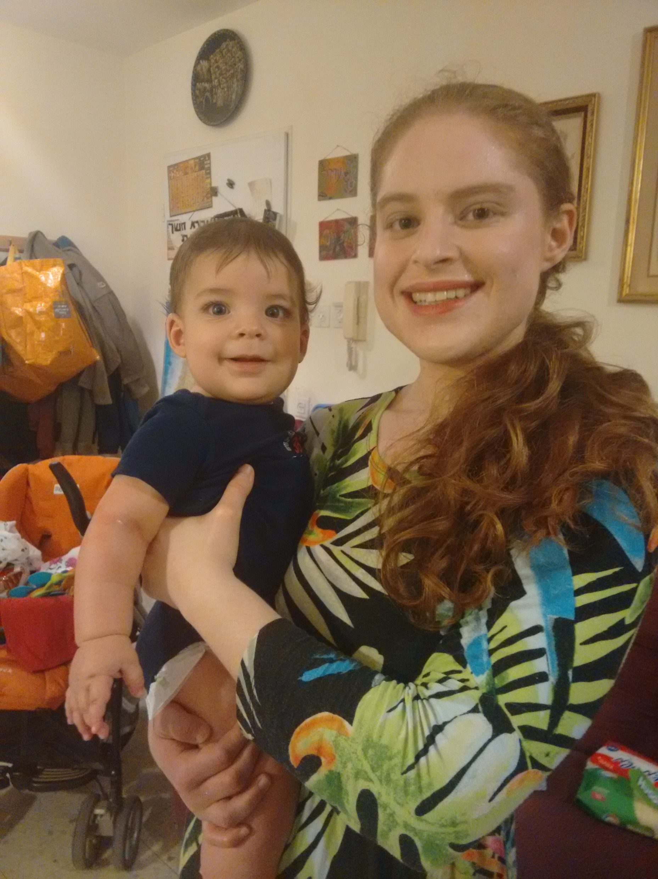

Slide 33
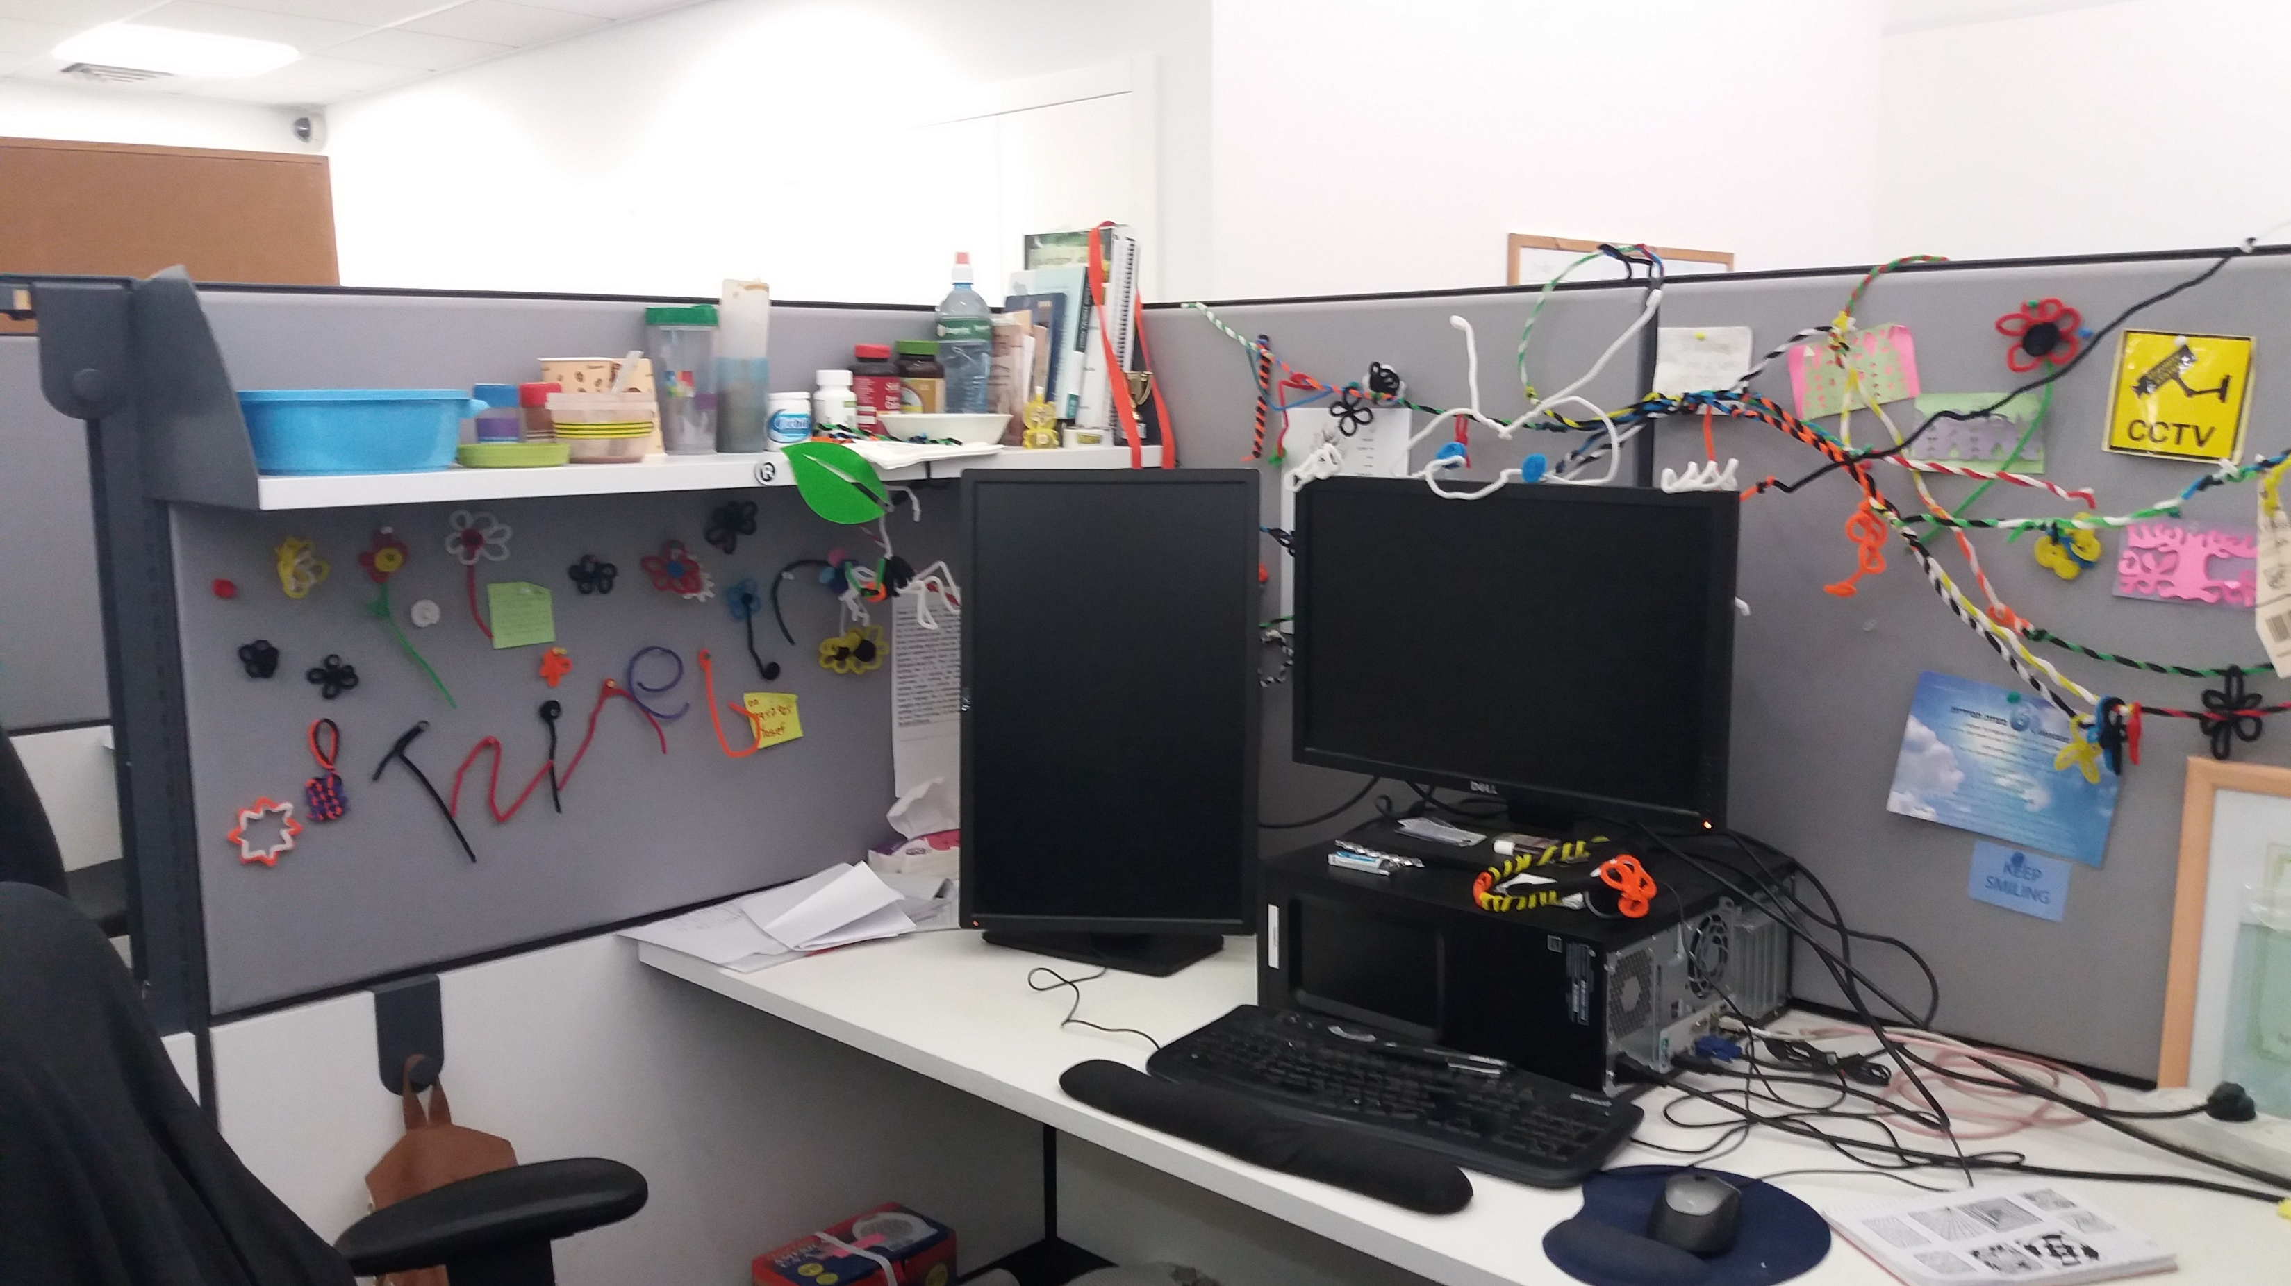

Slide 34
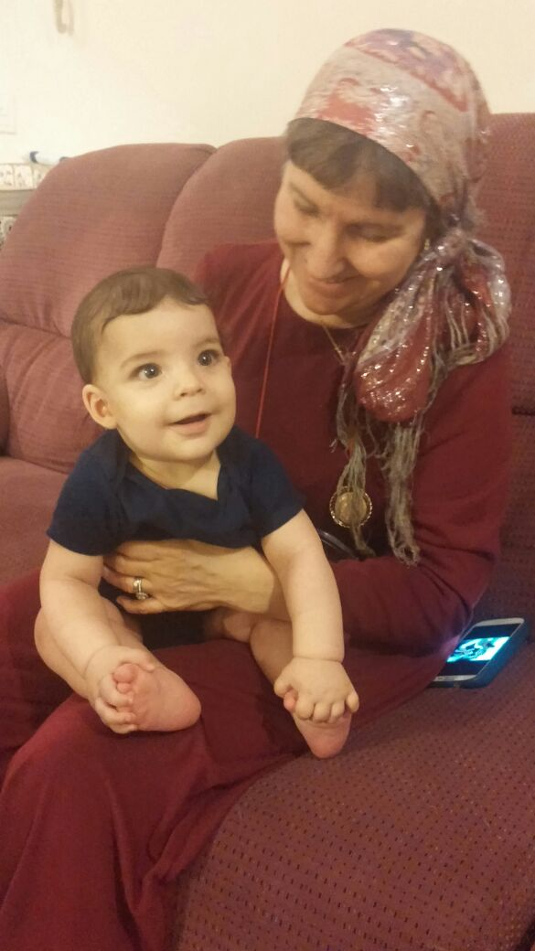

Slide 35
Nechama Eisenman
Marketing Compliance Coordinator

Slide 36
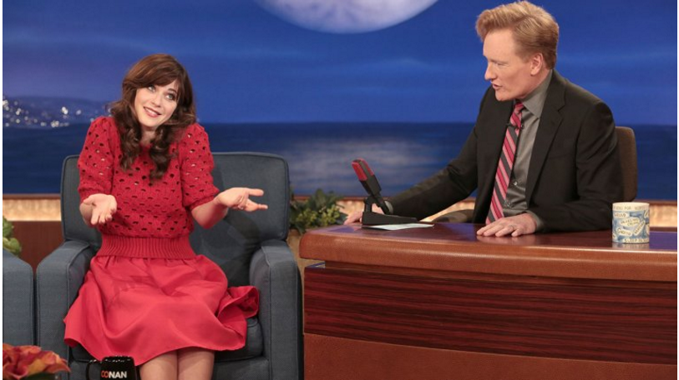

Slide 37



Slide 38
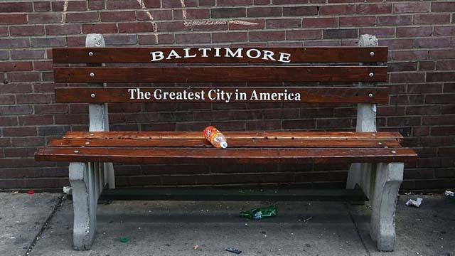

Slide 39
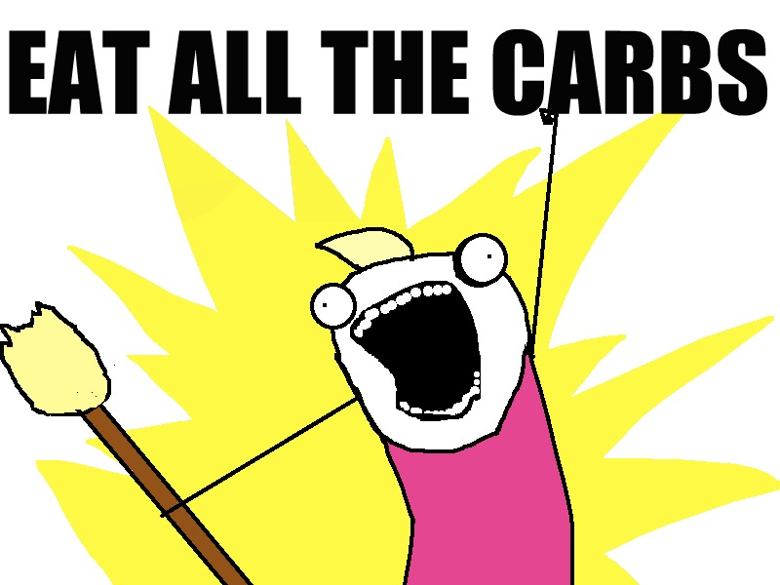

Slide 40
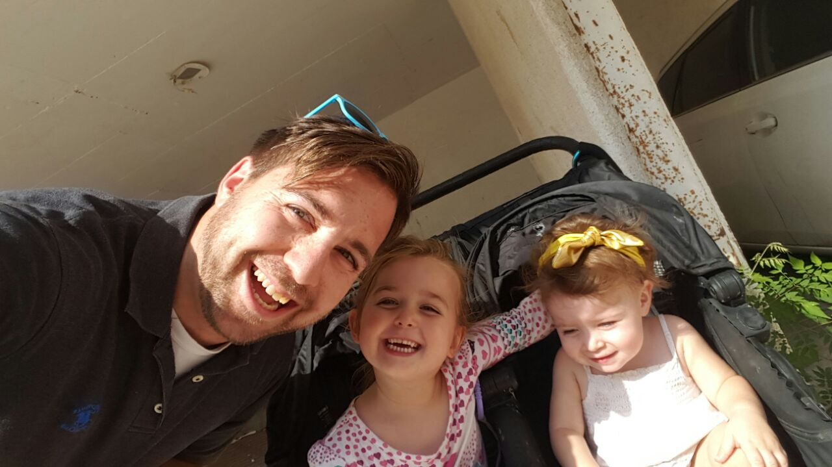
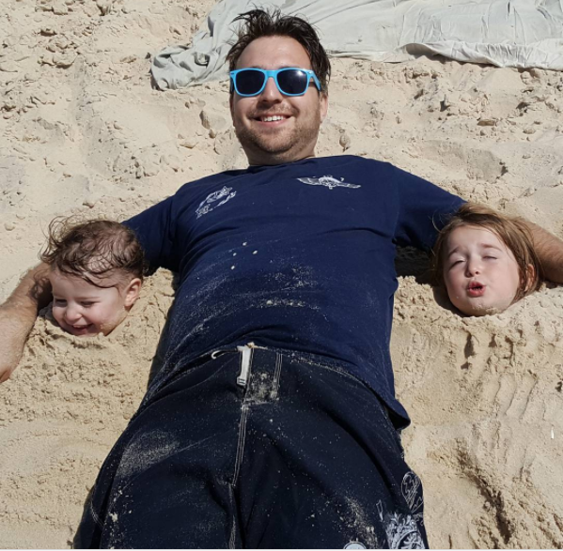
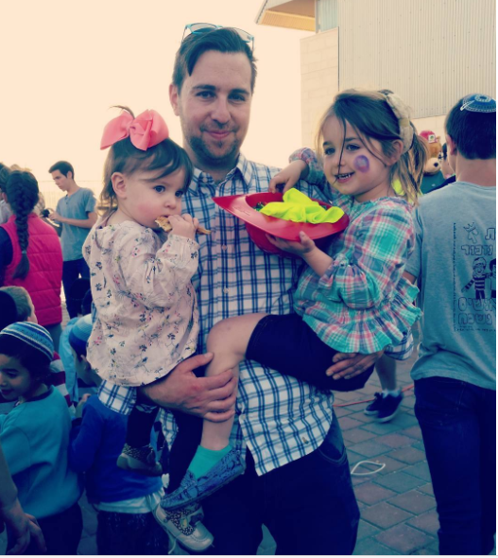

Slide 41

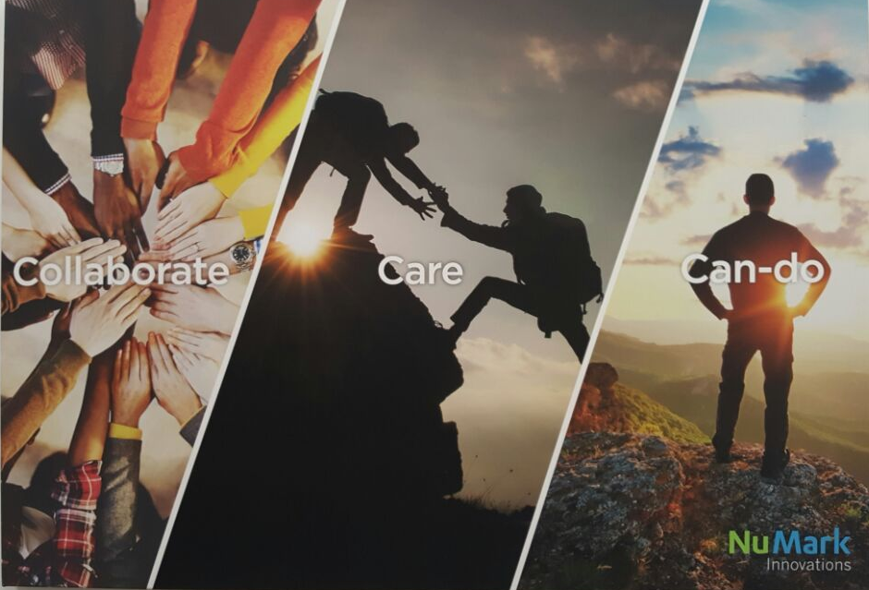

Slide 42
Eliyahu Goldshmit
CSRep
“The Face of the Company”

Slide 43
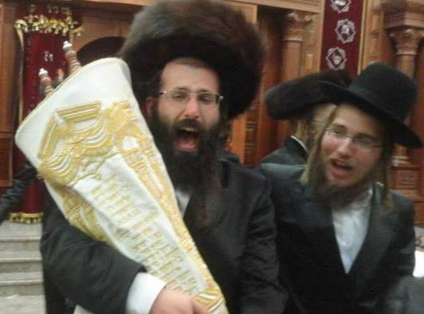
The Face of the Company?

Slide 44
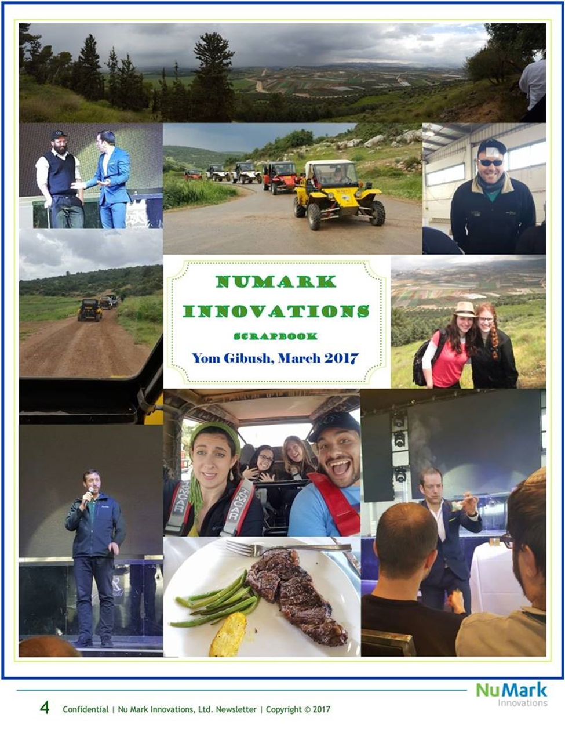
Meet the Real Face of our Company!

Slide 45
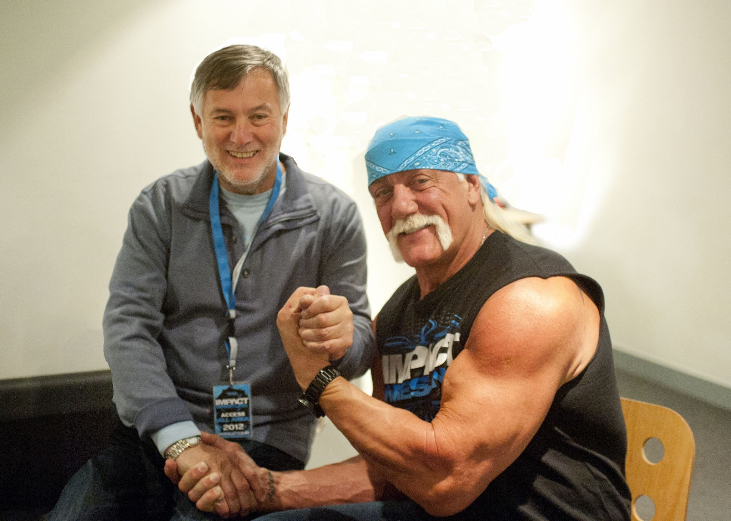
How Important is the Face?!

Slide 46
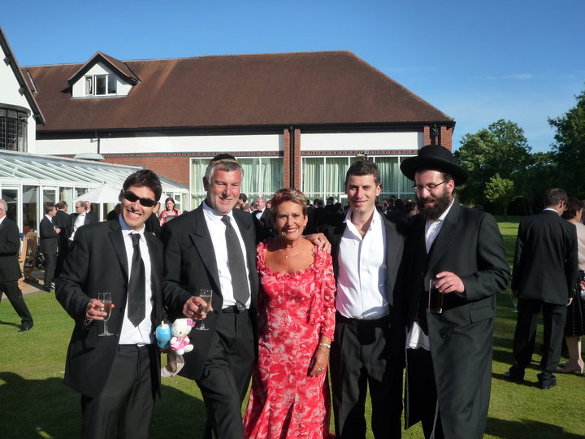
Family in London!

Slide 47
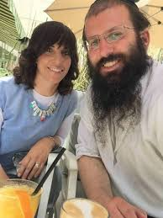

My family in the Judean Hills!

Slide 48

Loving people is what it is about!

Slide 49



CSREP for both Innovative Brands GS and M10!

Slide 50

Thank you for calling NMI and have a great day ☺!
My name is Eli G and I am CSREP for Mark10!

Slide 51
Eric Weisman
Quality and Operations Manager

Slide 52






Slide 53
Chava Jacobs
Front-End Developer

Slide 54


Notes:
Good morning! My name is Chavah. I was raised in Carlsbad, CA; graduated from UC Berkeley…

Slide 55

Notes:
And in 1998, I came to Israel in order to visit my sister and her nine-month old twins.
I have lived here every since.

Slide 56

Notes:
This is what the boys look like now. ☺

Slide 57

Notes:
While here, I met my husband, Eliahu…

Slide 58




Notes:
And we have four beautiful children,

Slide 59


Notes:
Plus four birds.

Slide 60

Notes:
Over 6 ½ years ago I started working for this company as a customer service representative.
For 2 ½ years I worked my way up that department, before I started feeling a bit restless.

Slide 61

Notes:
I moved over to marketing, where I successfully wrote content for 2 years, before again feeling that restlessness.

Slide 62

Notes:
At that time, the UX team was looking for a new front-end developer.
I said, “What about me? Teach me how to code!”

Slide 63
FEBRUARY
2015
Notes:
I remember in February of 2015, when I sat down for one of my first coding lessons, I remember feeling something inside of me clicking into place.
I remember thinking to myself, “This is what I should have been doing the whole time!”
That was a month before my 40th birthday, and I had finally found my place in the working world.

Slide 64

Notes:
I love coding.
I love building something beautiful and functional for others to use and enjoy.
I love that sometimes I get to be an investigator, searching for clues, looking for missing pieces of code, and finding a solution.

Slide 65

Notes:
I love that while I’m always told exactly WHAT I have to do, I’m not told HOW to do it.
This creates a space for me in which I can be creative, and where I can express myself.

Slide 66
For just as poetry reveals the inner world of a poet,
the style a person’s code reflects how they think.

Slide 67

Thank you
Notes:
I want to take this opportunity to thank Nu Mark Innovations for all of the training I’ve had and for all of the chances I’ve been given.

Slide 68

Notes:
I work on what I feel is the best team in the company, doing the best job in the world.

Slide 69


Slide 70
Gifts can be collected at a table here in the hall. "Fair Fun" will now continue outside.

